Slide 1

Rebuild Illinois Grant Administration
Thursday, October 19, 2023

Slide 2
Rebuild Illinois Administration
Award to Grant Agreement
Regina Watts

Slide 3
Process and Requirements
Before Grant can be issued…

Slide 4
Notice of State Award Finalist(NOSAF) Requirements:
Internal Control Questionnaire (ICQ) Financial and Administrative Risk Assessments are required to be completed once annually.
For questions about this process go to: What is the Annual Risk Assessment via the Grantee Portal FAQ at (gata.Illinois.gov/grantee-portal-faq.html)
Conflict of Interest & Mandatory Disclosures
Environmental Review Requirements
Procurement and Labor Standards Requirements
Other Special Grant Conditions as set forth in your NOSAF
Grantees are expected to complete all requirements identified on the NOSAF within 90 days of the date of the letter on the NOSAF.
Failure to complete requirements may result in forfeiture of the Grant Award.

Slide 5
Notice of State Award (NOSA)
NOSA is issued after all conditions of the NOSAF are met including establishing BEP Goals for the project.
The NOSA is Created by the Grant Manager and approved by the Deputy Director
Once approved by the Deputy Director the Grant Administrator will receive a system-generated e-mail that the NOSA is ready for acceptance.
It is important that the Administrator is listed in the Grantee’s record in the GATA portal as a contact.
The Grantee and or Grant Administrator must accept the NOSA by going to: omb.illinois.gov/Apps/GATA. Click on the GOMB Main menu then look for “Grant Accountability and Transparency Act (GATA)” and click on there.

Slide 6
Indirect Cost Selection
After acceptance of the NOSA
  New Grantees will receive an email invitation to select an indirect cost rate.
  Previous system, known as CARS, has been updated to the GATA Centralized Indirect Cost Rate System
  Selection made once, not annually
  Video for the process:
  https://illinois2.webex.com/recordingservice/sites/illinois2/recording/6ded53d0292b4a5cac585a00f0042353/playback

Slide 7
Grant Agreements
Grant Agreements are initiated after NOSA is accepted by the Grantee or the Grant Administrator.
Review the Grant Agreement to understand what it contains as it relates to your roles and responsibilities prior to signing off on the Grant Agreement.
  Such as certified assurances, financial and audit requirements, reporting schedules, monitoring, and reimbursement schedules under the grant
  Grant Agreement must be signed off by the Authorized Official or his or her authorized designee.
Return the signed Grant Agreement and budget via e-mail to your assigned Grant Manager at DCEO, Office of Community Development.

Slide 8
Rebuild Illinois Administration
Rebuild Illinois Grant Requirements
JoLaine Miner

Slide 9
Rebuild Illinois Grant Requirements
Compliance with State Law:
The Illinois Prevailing Wage Act (820 ILCS 130/)
The Employment of Illinois Workers on Public Works Act (30 ILCS 570/0.01 et seq.)
The Illinois Works Jobs Program Act (30 ILCS 559/20)
    Illinois Works Apprenticeship Initiative
The Business Enterprise Program for Minorities, Females, and Persons with Disabilities Act (“BEP”) (30 ILCS 575/0.01 et seq.)

Slide 10

Rebuild Illinois Grant Requirements
DCEO Grant Agreement
Exhibits A – G
  Cover Scope, Specific Requirements, Deliverables, Required Performance Measures.
Article 37 Grant Specific Terms and Conditions
Article III, 3.5 Specific Certifications, (o) IL Works Review Panel, (p) Anti-Discrimination – Required in all Contracts
Article VIII Lobbying – Required in all Contracts

Slide 11


Welcome to the Illinois Works Apprenticeship Initiative Program!

Slide 12
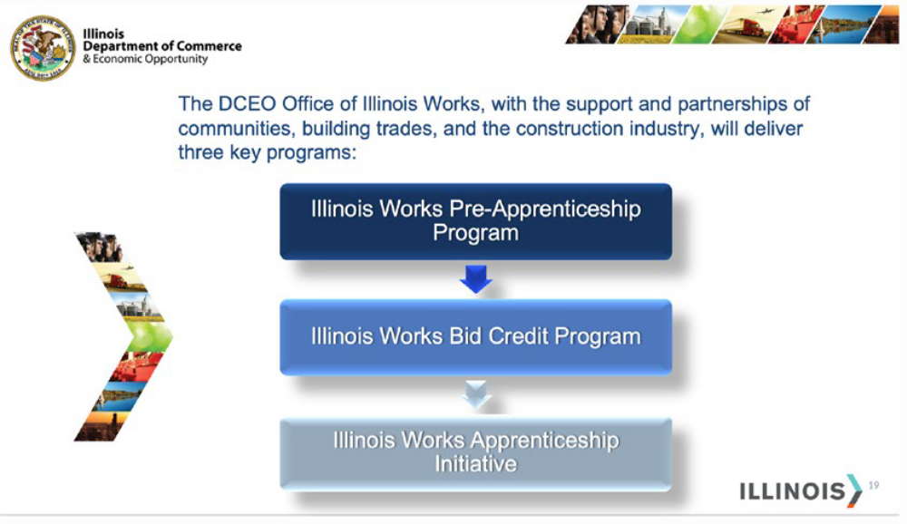
General Information
The Illinois Works Jobs Program Act is a statewide initiative to ensure that all Illinois residents have access to State capital projects and careers in the construction industry and building trades and to provide contracting and employment opportunities to historically underrepresented populations in the construction industry.
Three major components:
  The Illinois Works Pre-Apprenticeship Program;
  The Illinois Works 10% Apprenticeship Goal;
  The Illinois Works Bid Credit Program
Notes:
Pre-Apprenticeship Program-Creates the pipeline of candidates to help respond to the demand, the Apprenticeship-creates demand for jobs and apprentices, and the Bid Program-It’s essentially an incentive program that our graduates from the Pre-Apprenticeship program are hired and retained by contractors and subcontractors. Bid credit, incentive for contractors to hire and earn bids.

Slide 13
What is the Illinois Works Apprenticeship Initiative Goal?
This program opens the doors of opportunity into the construction industry and the trades. It applies to public works projects with an estimated cost of $500,000 or more, including both capital grants and direct capital contracts and awards. For applicable projects, the goal is for U.S. Department of Labor certified apprentices (not limited to pre-apprentice program graduates) to perform: 10% of total labor hours actually worked in each prevailing wage category OR 10% of the estimated labor hours in each prevailing wage category, whichever is less.

Slide 14
The Illinois Works Apprenticeship Initiative Program
The Illinois Works Apprenticeship Initiative sets an apprenticeship goal for public works projects estimated to cost $500,000 or more, including both capital grants and direct capital contracts.
Apprenticeship Goal is for US Dept. of Labor certified apprentices to perform:
10% of total labor hours actually worked on a project, or
10% of the estimated labor hours in each prevailing wage category, whichever is less.
“Public Works” means all projects contracted or funded by the state, in whole or in part, from appropriated capital funds that constitute a public work under the Prevailing Wage Act.
"Project" means the activities established by the agency and set forth in the Grant Agreement or contract that are funded, in whole or in part, by appropriated State funds.

Slide 15


Illinois Works Apprenticeship Initiative
Appropriated Capital Funds
$500,000 or more
If the percentage of State contribution of appropriated capital funds to the overall project is >50% or more of the estimated total project cost, the 10% apprenticeship goal applies to all prevailing wage eligible work performed by contractors on the entire project.
If the percentage of State contribution of appropriated capital funds to the overall project is less than <50% of the estimated total project cost, the 10% apprenticeship goal applies only to prevailing wage eligible work being funded from state appropriated capital funds.
less than $500,000
If the percentage of State contribution of appropriated capital funds to the overall project is >50% or more of the estimated total project cost, the 10% apprenticeship goal applies to all prevailing wage eligible work performed by contractors on the entire project.
If the percentage of State contribution of appropriated capital funds to the overall project is less than <50% of the estimated total project cost, the 10% apprenticeship goal does not apply.

Slide 16

IL Works Smartsheet Platform
Maintain, manage, and monitor
a database of hundreds of projects
across the state of Illinois.

Slide 17
Results as of 10/2023
Apprenticeship Initiative
 | Agency | Number of Projects | Specific Contract, Grant or Loan Obligation Amount
1 | IDOT | 246 | $8,326,694,782.76
2 | IEPA | 72 | $529,298,996.21
3 | CDB | 133 | $907,447,930.20
4 | DCEO | 181 | $464,293,679.12
5 | IL ARTS COUNCIL | 13 | $26,500,000.00
6 | IDNR | 4 | $24,400,000.00
7 | SOS | 5 | $21,529,207.97
8 | ISBE | 2 | $5,543,900.00
 | TOTAL | 656 | $10,305,708,496.26

Slide 18
IL Works Apprenticeship Compliance Process
Project Eligibility Require-ments
Budget Supple-ment
Update Request Form (Optional)
Periodic Report
Waiver (Optional)
Certificate
Notes:
Project Submission: Determine Project Eligibility if the apprenticeship goal might apply to the project
Budget Supplement: Capture all the trades that will be working on the project on the budget supplement
Periodic Report: Progress report-that is a clear indicator of what trades may be working during that quarter
Request Update Form (Optional): Request can be made during the life spam of a project to modify costs and dates
Waiver (Optional): If they cannot meet the 10% apprenticeship goal Loan/grantees/contractors need to submit a waiver/reduction request as soon as they know they may need a waiver/reduction and no later than 30 days after the project end date to their State Agency after submitting the budget supplement.
Certification: Close-out of a project

Slide 19
Progress and Compliance

Slide 20
IL Works and State Agencies Collaborate to Meet the
Illinois Jobs Program Act Requirements
Quarterly Compliance Meetings
Technical Assistance
Monitor Progress
Real time-Daily Contact via Smartsheet Platform
Notes:
Agencies responsibility to determine if the apprenticeship goal might apply to the project, ensure the grantee/contractor completes all the compliance forms, monitor grantee/contractor with apprenticeship goals, and finally close out and collect the certification to then submit it to IL Works.

Slide 21
Upcoming Changes for the Remainder of this Year, Going Into 2024
The new legislated goal which is that (5%), half of the (10%) goal of the apprenticeship hours, is to be performed by IL Works, Climate Works, or IDOT pre-apprenticeship programs graduates.
The Apprenticeship initiative will conduct monthly information webinars on procedures and technical steps.

Slide 22
And Support the Overall Goals of the Illinois Works Office
Provide a career pathway for residents in disadvantaged communities.
Provide eligible apprentices with the skills for lifelong job security.
Promote construction as a viable job industry for women and minority communities.
Provide construction industry with consistent skilled workforce for generations to come.
Create new partnerships between state agencies and community organizations.
Notes:
Through successfully partnering with community stakeholders, the Illinois Works Office will achieve the following goal:

Slide 23


Slide 24
For additional information, who do I contact?
DCEO- Office of Community Development Agency Contacts
JoLaine, Program Compliance Manager, Office of Community Development
jolaine.miner@illinois.

Slide 25
Rebuild Illinois Administration
Illinois Works Requirements
Sameena Aghi

Slide 26
Rebuild Illinois Grant Requirements
Rebuild Illinois Grants are subject to:
Illinois Works Jobs Program Act (30 ILCS 559/20).
Included in Exhibit A of the Grant Agreement

Slide 27
Rebuild IL Grant Requirements
The Grantee and Grant Administrator will receive these documents, following receipt of the executed grant agreement:
  Rebuild IL Contract Provisions
  BEP Utilization Goal Letter and BEP Utilization Plan
  IL Works Apprenticeship Initiative Project Update form (new)
  Good Faith Effort Guidance
  IL Works Budget Supplement

Slide 28
Language must be included in Contracts and Subcontracts
Illinois Works Jobs Program Act (30 ILCS 559/20-1 et seq.): For grants with an estimated total project cost of $500,000 or more, the grantee will be required to comply with the Illinois Works Apprenticeship Initiative (30 ILCS 559/20-20 to 20-25) and all applicable administrative rules. The “estimated total project cost” is a good faith approximation of the costs of an entire project being paid for in whole or in part by appropriated capital funds to construct a public work. *The goal of the Illinois Apprenticeship Initiative is that apprentices will perform either 10% of the total labor hours actually worked in each prevailing wage classification or 10% of the estimated labor hours in each prevailing wage classification, whichever is less. Grantees will be permitted to seek from the Department a waiver or reduction of this goal in certain circumstances pursuant to 30 ILCS 559/20-20(b). The grantee must ensure compliance for the life of the entire project, including during the term of the grant and after the term ends, if applicable, and will be required to report on and certify its compliance.
*to be updated and specified further

Slide 29
Apprenticeship Initiative
The Illinois Works Apprenticeship Initiative sets an apprenticeship goal for public works projects estimated to cost $500,000 or more.
Apprenticeship Goal is for US Dept. of Labor certified apprentices to perform:
10% of total labor hours actually worked on a project, or
10% of the estimated labor hours in each prevailing wage category, whichever is less.
“Public Works” means all projects contracted or funded by the state, in whole or in part, from appropriated capital funds that constitute a public work under the Prevailing Wage Act.
"Project" means the activities established by the agency and set forth in the Grant Agreement or contract that are funded, in whole or in part, by appropriated State funds.

Slide 30
Apprenticeship Initiative
Illinois Works Budget Supplement
Illinois Works Budget Supplement
  Used to determine if the Apprentice Initiative applies to the grant-funded project and to monitor compliance
If yes, Quarterly Reports (periodic reporting form) required
  Submit these via email to your DCEO grant manager & copy CEO.LSO@illinois.gov
  Both documents can be found at: https://dceo.illinois.gov/illinoisworks/apprenticeship.html

Slide 31
App Apprenticeship Initiative
  Does the goal apply to the entire project or only the grant-funded work?
  For projects estimated to receive $500,000 or more:
  If grant funds contribute 50% or more of the estimated total project cost, the 10% apprenticeship goal applies to the entire project.
  If grant funds contribute less than 50% of the estimated total project cost, the 10% apprenticeship goal applies only to grant-funded work.
  For projects estimated to receive less than $500,000, but the project cost is $500,000 or more:
  If grant funds contribute 50% or more of the estimated total project cost, the 10% apprenticeship goal applies to the entire project.
  If grant funds contribute less than 50% of the estimated total project cost, the 10% apprenticeship goal does not apply.

Slide 32
Apprenticeship Initiative Request for Waiver or Reduction form
DCEO Illinois Works Office may reduce or waive the 10% apprenticeship goal upon a determination that:
  the applicant, grantee, contractor or subcontractor has demonstrated that insufficient apprentices are available;
  the reasonable and necessary requirements of the contract or grant do not allow the goal to be met;
  there is a disproportionately high ratio of material costs to labor hours that makes meeting the goal infeasible; or
  apprentice labor hour goals conflict with existing requirements, including federal requirements, in connection with the public work.

Slide 33
Apprenticeship Initiative Certificate of Compliance
Each Grantee must certify compliance by submitting a Certificate:
  DCEO OCD will review the form and submit to DCEO Illinois Works Office
    Grantee must certify that either the goal has been met or a waiver request was submitted and granted, if not met
  Completed at End of Grant/Contract
  Completed at End of Project
    Must be monitored (Quarterly Reporting) until certification is submitted

Slide 34
Resources
https:/ hthttps://dceo.Illinoi
tpshttps://dceo.illinois.gov/illinoisworks/apprenticeship.html://dceo.illdceo.Illinois.gov/illinoisworks/apprenticeship.htmltml
https://www.illinoisworknet.com/ApprenticeshipIL/Pages/default.aspx

Slide 35
Rebuild Illinois Administration
Business Enterprise Program (BEP) Requirements
JoLaine Miner

Slide 36
Business Enterprise Program (“BEP”)
All Rebuild Illinois grants are subject to:
Business Enterprise Program for Minorities, Females, and Persons with Disabilities Act (“BEP”) (30 ILCS 575/0.01 et seq.).

Slide 37
Business Enterprise Program (“BEP”)
Language must be included in Contracts and Subcontracts (with the BEP Utilization Plan for completion)
Grantee is required to comply with the Business Enterprise Program for Minorities, Females, and Persons with Disabilities Act (“BEP”) (30 ILCS 575/0.01 et seq.), which establishes a goal for contracting with businesses that have been certified as owned and controlled by persons who are minority, female or who have disabilities. Grantee shall maintain compliance with the BEP Utilization Plan submitted in conjunction with the Agreement and shall comply with all reporting requirements.

Slide 38
Business Enterprise Program (“BEP”)
Establishes a goal for contracting with businesses that have been certified as owned and controlled by persons who are minority, female or who have disabilities.
Requires the application of a BEP Utilization Goal for all state-funded contracts
Grantees must submit a Utilization Plan for the established BEP (MBE/WBE) goal sent in conjunction with the executed Grant Agreement.

Slide 39
Business Enterprise Program (“BEP”)
How is the BEP utilization goal determined?
Grant Funds
Scope of the Project
Availability of CEI BEP certified vendors in the area to perform the work
How do I know what my goal is?
BEP goal letter will be sent after the executed Grant Agreement
Utilization Plan must be used as part of procurement, completed and returned
  Send to ceo.lso@illinois.gov

Slide 40
Business Enterprise Program (“BEP”)
  Can I start procuring for professional services related to the construction of my project prior to receiving the goal/plan, but not award the contract?
  NO
No Rebuild Illinois grant-funded costs can be incurred prior to the receipt of the executed Grant Agreement and the application of the Business Enterprise Program (BEP) utilization goal. Professional Services costs, paid for with other funding, while still subject to 2 CFR 200, may be incurred after the receipt of the Environmental Clearance letter.

Slide 41
BEP – Utilization Plan
  Must demonstrate that the Grantee has met the UP goal or made a good faith effort to do so.
  Value of work performed - Construction Activities, including subcontracts (must be State of IL CEI BEP certified)
  Materials, supplies obtained from a State of IL CEI BEP Certified Vendor

Slide 42
BEP – Utilization Plan
  Fees to certified vendors for a professional service required for the performance of the grant agreement
  Fees for the delivery of materials when the hauler, trucker, or delivery service is not also the manufacturer/dealer. The certified vendor trucking firm must own and operate at least on fully licensed, insured and operational truck used on the project and fully manage, supervise the entire trucking operation.
    Provided the fee is determined to be reasonable and not excessive as compared with fees customarily allowed for similar services.

Slide 43
BEP – Utilization Plan
  General office overhead or grantee support activities are ineligible expenditures and shall not be counted.

Slide 44
BEP – Utilization Plan
  Assurance and Compliance, including Grantee’s Authorized Official’s signature
  Complete Section I for each CEI BEP Certified Vendor, including Authorized Official’s signature
  Complete Section II (Demonstration of Good Faith Efforts), including Authorized signature, and ONLY IF:
    The BEP contracting/subcontracting goal was not achieved
    Must include supporting documentation and letter of explanation

Slide 45
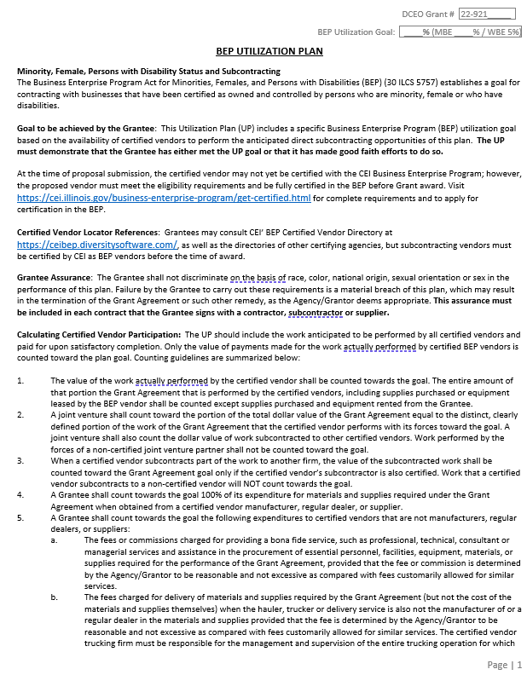
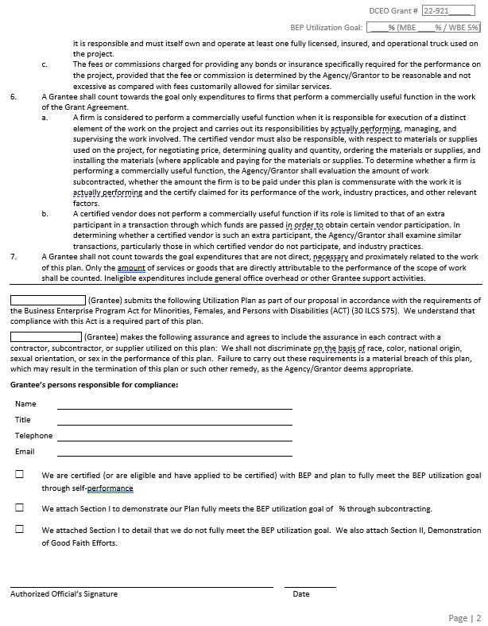
BEP Utilization Plan - Assurance & Compliance

Slide 46
BEP Utilization Plan - Assurance & Compliance
  First two page of the BEP Utilization Plan
  1 - Must be completed by the Prime Contractor/Bidder as part of procurement process
  2 - Submit an “Assurance and Compliance” section signed by the Grantee’s Authorized official.
    Make sure the appropriate box is checked before submitting the Plan for approval.

Slide 47
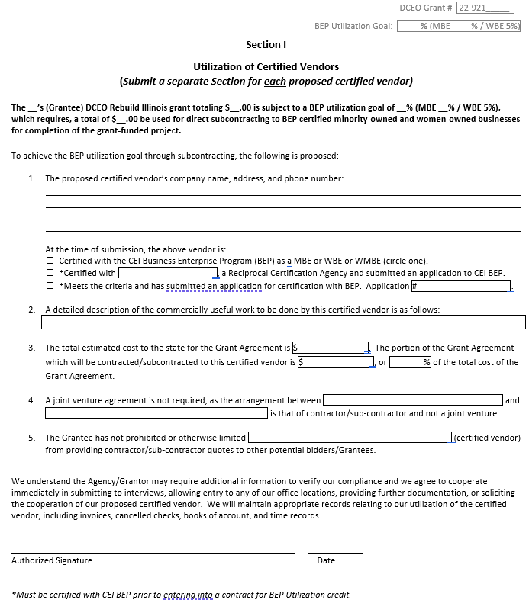
BEP Utilization Plan - Section I – Utilized Vendors
  Complete Section I for each CEI BEP Certified Vendor, including Authorized Signature
  Grantee > Prime
  or
  Prime > Subcontractor

Slide 48
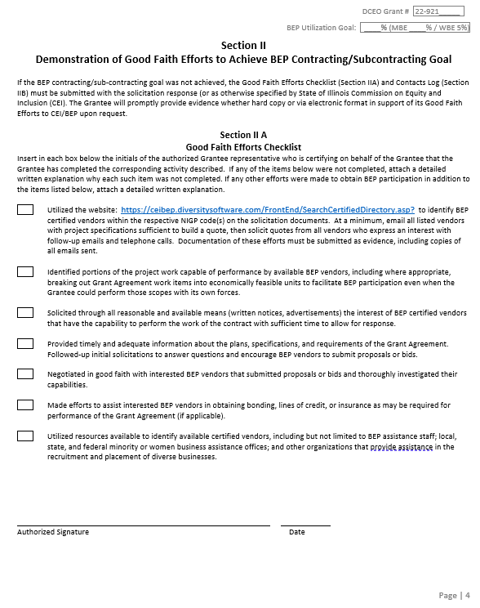
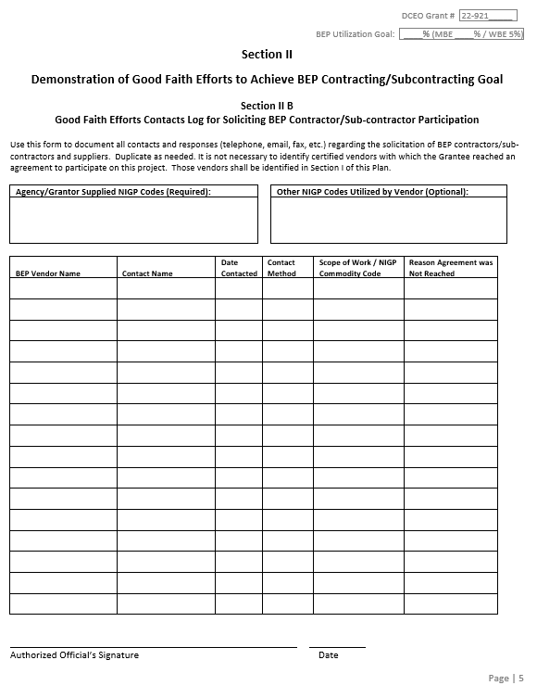
BEP Utilization Plan - Section II – Good Faith Efforts

Slide 49
BEP Utilization Plan - Section II – Good Faith Efforts
  Good Faith Efforts must be fully documented for a BEP Utilization Plan to be accepted and the contractor to be considered “responsive” when the Utilization Goal is not met.
  ALL Good Faith Efforts in Section II must be completed.
    If not completed, a written, detailed explanation must be provided with the Utilization Plan.

Slide 50
BEP Utilization Plan - Section II – Good Faith Efforts
Identify portions of the project work capable of performance by available BEP vendors, including where appropriate, breaking out Grant Agreement work items into economically feasible units to facilitate BEP participation.
    See NIGP Codes in Section IIB set by Agency, or list additional codes used
    https://ceibep.diversitysoftware.com/

Slide 51
BEP Utilization Plan - Section II – Good Faith Efforts
Solicit through reasonable and available means (e.g., written notices, advertisements) BEP vendors to perform the types of work that could be contracted on this project, within sufficient time to allow them to respond.
Minimum 10 days from Bid Opening

Slide 52
BEP Utilization Plan - Section II – Good Faith Efforts
Provide timely and adequate information about the plans, specifications, and requirements of the Grant Agreement. Follow up initial solicitations to answer questions and encourage BEP vendors to submit proposals or bids.
Advertise
Send individual Notice via Email
Follow-up via secondary means
Make follow-up phone calls
Create a Contact/Phone log – Section II B
Document all forms of contact made
Use at least two minority focused entities or media outlets, including trade associations, minority/women community organizations or contractor’s groups, and business assistance offices.

Slide 53
BEP Utilization Plan - Section II – Good Faith Efforts
Negotiate in good faith with interested BEP vendors that submitted proposals or bids and thoroughly investigate their capabilities.
Document names, address and phone number of BEP firms considered.
Fully document information provided including plans/specs including means used; and the evidence as to why agreement could not be reached.
Consider BEP subcontractor’s price and capabilities as well as contract goals.
Additional costs involved in finding and using BEP firms in NOT sufficient reason for failure to meet the contract BEP goal as long as costs are reasonable.

Slide 54
BEP Utilization Plan - Section II – Good Faith Efforts
Make efforts to assist interested BEP vendors in obtaining bonding, lines of credit, or insurance as may be required for performance of the Grant Agreement, if applicable.
Utilize resources available to identify available certified vendors, including but not limited to BEP assistance staff; local, state and federal minority or women business assistance offices; and other organizations that provide assistance in the recruitment and placement of diverse businesses.

Slide 55

BEP Utilization Plan – Contractor Certification
Does the Contractor/Vendor have to be certified with CEI BEP as an MBE/WBE to be counted toward meeting the BEP UP goal?
Full BEP Certification
Full BEP Certification is valid for 7 years for MBE/WMBE/WBE. Each year vendors must file No Change Affidavits to maintain their certification. Certification takes approximately 60 days.
Please see the Certification Application Checklist available at:
https://cei.illinois.gov/business-enterprise-program/get-certified.html
To register, visit:
CEIBEP.diversitysoftware.com
  Click on “Apply for BEP and/or VBP Certification”

Slide 56
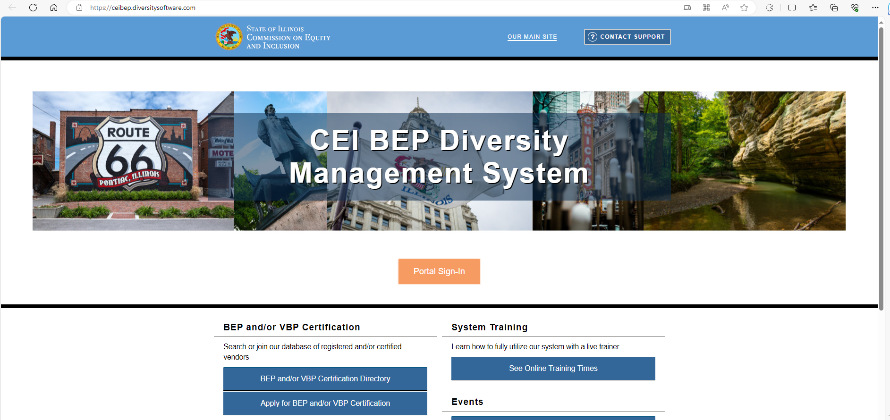
BEP Utilization Plan – Contractor Certification
https://ceibep.diversitysoftware.com

Slide 57
BEP Utilization Plan – Contractor Certification
BE Enrolled in BEP
The Illinois Commission on Equity & Inclusion has expanded its BE Enrolled in BEP (BE BEP) program to allow vendors certified by the Illinois Unified Certification Program (IL UCP) to become automatically enrolled as certified BEP vendors.
This includes vendors enrolled in:
Chicago Transit Authority
METRA (Chicago commuter train system)
PACE (Chicago bus system)
IDOT (IL Dept of Transportation

Slide 58
BEP Utilization Plan – Contractor Certification
Fast Track Certification
FastTrack Certification allows vendors who were certified by one of the partner organizations listed below to apply for BEP Certification. Vendors must submit proof of certification from a FastTrack and a signed and notarized BEP/VBP application affidavit to the BEP Certification Unit for review and approval. FastTrack Certification is valid for one year
Chicago Minority Supplier Development Council
Mid-States Minority Supplier Development Council
Women’s Business Development Center

Slide 59
BEP Utilization Plan – Common Questions
I submitted my plan but was unable to meet the goal. Can I move forward and award the construction contracts?
Contracts should not be awarded until you receive the BEP Utilization Plan approval letter from the Department.
BEP Utilization Plans that do not meet the UP Goal and request a waiver for reduction, must include all documentation to support good faith efforts and a letter of explanation.

Slide 60
BEP Utilization Plan – Common Questions
We just opened bids and none of the responding bidders met the UP goal, do we need to rebid the project?
  You are allowed to afford all responsive bidders the same 10-day cure opportunity to seek additional CMS-BEP certified vendors to participate in the grant-funded construction project.
  One of our bidders did not complete the BEP UP, do we include that bidder in the 10-day cure opportunity?
  A bidder who does not submit the BEP UP is considered non-responsive.
  (30 ILCS 575/4(e))

Slide 61
BEP Utilization Plan – Common Questions
  Our lowest bidder completed the BEP UP, but did not meet the goal, and did not submit good faith documentation. The second lowest bidder met the goal. What do we do?
  Award to the second lowest bidder.
  Even though the lowest bidder submitted the Plan, he is non-responsible because he did not meet all the requirements of the grant.
I submitted my plan, but the WBE I contracted with can’t continue on the project. What do I do?
  The BEP Change of Vendor Form will be sent after the Department’s review and approval of the BEP Utilization Plan.

Slide 62
BEP Utilization Plan – Common Questions
  Can a WMBE be counted as both an MBE and WBE in order to meet the utilization goal?
You must count a WMBE as either an MBE or a WBE. It is recommended that you count the WMBEs as MBE first since that goal is assessed at a higher rate than WBE.

Slide 63
BEP Utilization Plan – Common Questions
How does BEP compliance affect my Grant Funds?
DCEO grant funds for construction are not released until the BEP Utilization Plan is submitted and approved.
Lien Waivers will be sent after the Department’s review and approval of the BEP Utilization Plan.
Grantees must submit Partial Lien Waivers with Requests for Payment in order to receive grant funds. The lien waivers are compared with the Utilization Plan to ensure compliance prior to approval and release of grant funds.

Slide 64
BEP Utilization Plan – Common Questions
How does BEP compliance affect my Grant Funds?
The Final Request for Payment shall include the Final Lien Waiver, which includes the amount of all contracts from subcontractors and suppliers for which final lien waivers were not previously submitted.
The Department will hold the amount of grant funds applicable to the BEP goal percentage until all CEI BEP certified vendors have been paid and the BEP Utilization goal is met.

Slide 65

Rebuild Illinois Administration
Business Enterprise Program (BEP)
JoLaine Miner
Please contact me if you have any questions
IL Dept of Commerce & Economic Opportunity
607 E. Adams, 3rd Floor
Springfield, IL 62701
Phone: 217.558.4222
Email: ceo.lso@Illinois.gov
Thank You!

Slide 66
Rebuild Illinois Administration
2 CFR 200 Procurement Standards
Covers Current DCEO OCD Rebuild Illinois Grants as of October, 2023
Kirk Kumerow

Slide 67
2 Code of Federal Regulations (CFR) 200
  Subtitle A, “Office of Management and Budget Guidance for Grants and Agreements” became effective as uniform Federal guidance on 12/26/2014;
  Originally Called OMB “Super Circular” in 2011;
  Launched by Obama administration to streamline guidance for federal awards to ease the administrative burden and costs
  across Federal agencies’ funding programs.

Slide 68
2 CFR 200
  In 2014, Illinois General Assembly passed and Governor signed 30 ILCS 708/20 “Adoption of federal rules applicable to grants”;
  Made rules under Federal 2 CFR 200 binding on State of Illinois-funded grants;
  Goals of efficiency and better grant
  tracking and enforcement.

Slide 69
2 CFR 200.317-.326 Procurement Standards
§200.317 Procurements by states
§200.318 General procurement standards
§200.319 Competition
§200.320 Methods of procurement to be followed
§200.321 Contracting with MBE, et. al.
§200.322 Procurement of recovered materials
§200.323 Contract cost and price
§200.324 Federal agency or pass-through entity review
§200.325 Bonding requirements
§200.326 Contract provisions

Slide 70
2 CFR 200.318 General Procurement Standards
Use local procedures if conform with federal law
Maintain contractor oversight
Maintain written standards of conduct for all employees
Use most economical approach
Use intergovernmental or inter-entity agreements
Use federal excess/surplus property
Use value engineering
Use responsible contractors
Maintain procurement records
Use T&M contracts only if necessary
Local grantee responsible for all aspects of contract

Slide 71
2 CFR 200.319 Competition
Full, open and competitive procurement process
  No unreasonable requirements
  No unnecessary experience or bonding requirement
  No noncompetitive pricing among firms
  No noncompetitive retainer contracts
  No conflicts of interest
  No “brand name” requirement
  No arbitrary actions
No geographic preference
Must have written procedures
  Include technical description of work or product
  Include criteria for proposal evaluation
If pre-qualified lists are used they must be current

Slide 72
2 CFR 200.320 Methods of Competition - CDBG
Procurement by micro-purchases – Rare for Rebuild Illinois
Procurement by small purchase procedures – Can be for Rebuild Illinois A/E
Procurement by sealed bids (formal advertising) – All Rebuild Illinois Construction
Procurement by competitive proposals – Can be for Rebuild Illinois A/E
(intentionally left blank)
Procurement by noncompetitive proposals –
Generally not for Rebuild Illinois

Slide 73
Micro-Purchases & Small Purchase Procedures
Procurement by micro-purchase ($10,000 or less; $2,000 or less for Construction)
Procurement by small purchase procedures (Less than $250,000 anticipated cost)
For DCEO OCD Rebuild Illinois, may be used for equipment purchase or A/E services
Phone, mail or e-mail solicitation acceptable (document efforts)
Solicit at least three potential qualified bidders
Make bid packet available for pick up, mailing or e-mailing
No less than two bidders (if one bidder; document reason)
vi. A/E services may include price as a factor,
but not the sole factor

Slide 74
Procurement by Sealed Bids (Formal Advertising)
Procurement of Rebuild Illinois or “other-funded” construction above $2000 listed in a Grant Agreement must be by sealed bids (formal advertising)

Slide 75
Procurement by Sealed Bids (Formal Advertising)
Procurement by sealed bids (formal advertising)
  Proposals must have:
    Detailed description
    Two or more responsible bidders
    Require a firm, fixed price offer

Slide 76
Procurement by Sealed Bids (Formal Advertising)
  2) Bidding requirements:
    Publicly advertised with sufficient notice
    Sufficient specifications
    Public bid opening
    Contract to lowest responsible qualified bidder
    Reject bids only for sound reason

Slide 77
2 CFR §200.324 Contract Cost and Price
Price analysis for contract and modifications
Profit calculation for contracts with no price competition
Estimated cost contract – Subpart E-Cost Principles
Cost-plus contracts are not allowed

Slide 78
2 CFR §200.32 DCEO Review
Must make specifications available to DCEO
Must make RFP, invitation to bid, et. al. available when:
  Vary from 2 CFR 200 standards
  Only one bid/response
  “Brand name” product
  Award to non-low bidder
  Contract is above Simplified Acquisition Threshold (for non-construction contracts)
Exemption from pre-procurement review

Slide 79
2 CFR §200.326 Bonding Requirements
Applies to construction or facility improvement contracts
Bid bond of 5% of bid
Performance bond of 100% of the contract price
Payment bond of 100% of the contract price
Copies of bonds must be maintained in grant administrator’s files, available to Rebuild Illinois monitor before monitoring visit

Slide 80
Rebuild Illinois Administration
Contract Provisions for Grantees
Mandatory items to be included in Grantees’ contracts with Prime Contractor
Peyton Bernot

Slide 81
Subjects Covered
When posting for bids include information the project is a public work and prevailing wages must be paid.
Illinois Prevailing Wage Act [820 ILCS 130]
Employment of Illinois Workers on Public Works Act [30 ILCS 570]
Illinois Works Jobs Program Act [30 ILCS 559/20]
Business Enterprise Program for Minorities, Females and Persons with Disabilities Act (“BEP’) [30 ILCS 575]
Unlawful Discrimination

Slide 82
Illinois Prevailing Wage
Legal Obligation
  Inform the bidders in the solicitation and advertisement for bids the Contractor selected must pay no less than the prevailing wage rate as ascertained by the Department of Labor and comply with the Illinois Wages of Employees on Public Works Act.
P.A. 100-1177
  Amended the Prevailing Wage Act to stipulate the Department of Labor will ascertain the rates of prevailing wages as opposed to the locality.
  https://labor.illinois.gov/laws-rules/conmed/current-prevailing-rates.html

Slide 83
Bid Language - Protect Yourself
Contractor shall not pay less than the prevailing rates of wages to all laborers, workmen, and mechanics performing work under this contract, and shall comply with the requirements of the Illinois Wages of Employees on Public Works Act (820 ILCS 130/1-12).

Slide 84
Prevailing Wage Continued
DO NOT USE conditional language such as“when and where applicable” in your contract with the contractor.
  Illinois Supreme Court has ruled these terms do not clearly stipulate the requirement of a contractor to pay prevailing wage Valerio v. Moore Landscapes, LLC, 2021 IL 126139 (Ill. 2021)
  It is the responsibility and duty of the Public Body to determine what jobs on a Public Work are to be paid Prevailing Wages.
    Starting in January 2024 powerwashing will be covered under the Act (P.A. 103-0346 eff. 1/1/2024 [H.B. 3370 Manley/ Castro])

Slide 85
Contract Language - Protect Yourself
This contract calls for the construction of a “public work,” within the meaning of the Illinois Prevailing Wage Act, 820 ILCS 130/.01 et seq. (“the Act”). The Act requires contractors and subcontractors to pay laborers, workers and mechanics performing services on public works projects no less than the current “prevailing rate of wages” (hourly cash wages plus amount for fringe benefits) in the county where the work is performed. The Department publishes the prevailing wage rates on its website at http://labor.illinois.gov/. The Department revises the prevailing wage rates and the contractor/subcontractor has an obligation to check the Department’s web site for revisions to prevailing wage rates. For information regarding current prevailing wage rates, please refer to the Illinois Department of Labor’s website. All contractors and subcontractors rendering services under this contract must comply with all requirements of the Act, including but not limited to, all wage requirements and notice and record keeping duties.

Slide 86
Prevailing Wage Continued
If you do not know if a particular job is covered under the Act-ASK.

Slide 87
Employment of Illinois Workers on Public Works Act [30 ILCS 570]
Applicable when there is “Excessive Unemployment”
  Two (2) consecutive calendar months of 5%+ of unemployment as measured by BLS
    Contractor is required to have at minimum 90% of workers from Illinois on a public works project
    Applies when workers are hired (not when contracts or agreements are executed).

Slide 88
Contract Language - Protect Yourself
Employment of Illinois Workers on Public Works Act (30 ILCS 570/0.01 et seq.) (the “Act”) provides that whenever there is a period of excessive unemployment in Illinois (as defined by the Act), if the Grantee is using Grant Funds for (1) constructing or building any public works, or (2) performing the clean-up and on-site disposal of hazardous waste for the State of Illinois or any political subdivision of the State, then the Grantee shall employ at least 90% Illinois laborers on such project. Illinois laborers refers to any person who has resided in Illinois for at least 30 days and intends to become or remain an Illinois resident. Grantee may receive an exception from this requirement by submitting a request and supporting documents certifying that Illinois laborers are either not available, or are incapable of performing the particular type of work involved. In addition, every contractor on a public works project or improvement or hazardous waste clean-up and on-site disposal project in this State may place on such work no more than 3 (or 6 in the case of a hazardous waste clean-up and on-site disposal project) of the contractor’s regularly employed non-resident executive and technical experts.

Slide 89
Illinois Works Jobs Program Act [30 ILCS 559/20]
Illinois Works Apprenstiship Initiitve [30 ILCS 559/20-20]
  Requires 10% of the total labor hours worked in each prevailing wage classifgication or 10% of the estimate for grants $500,000 and more
    If the State’s grant is less than $500,000 but represents 50% or more of the total project cost-the Act still applies (14 Ill. Adm. Code 680.30 (d)(1))
      Only applies to capital funded grants.

Slide 90
Contract Language - Protect Yourself
For grants with an estimated total project cost of $500,000 or more, the grantee will be required to comply with the Illinois Works Apprenticeship Initiative (30 ILCS 559/20-20 to 20-25) and all applicable administrative rules. The “estimated total project cost” is a good faith approximation of the costs of an entire project being paid for in whole or in part by appropriated capital funds to construct a public work. A goal is set for contractors to use apprentices for 10% of total labor hours worked in each prevailing wage classification on a project, or 10% of the estimated labor hours in each prevailing wage classification, whichever is less. Contractors will be required to report all labor hours performed on a project and the total labor hours performed by apprentices for each prevailing wage category. It is imperative that reports are submitted timely and accurately. Additional reporting will be required including a Budget Supplement to establish the use applicability of the apprenticeship requirement and the applicable wage classifications, which includes a certification of compliance – this form will be required any time there is a change to the project term, scope, or work force. Waivers may be requested in special circumstances. Grantees should contact their individual grant manager or program contact for waiver forms or to request additional information.

Slide 91
Contract Language - Protect Yourself Continued
Contractors, including subcontractors, should be reminded at every pre-construction conference that the requirements of the Act must be adhered to.

Slide 92
Contract Language - Protect Yourself Continued
It is essential for all parties to understand the 10% apprenticeship goal applies to each prevailing wage classification rather than the overall hours of work performed on a project. Exceeding the 10% goal in one prevailing wage classification will not make up for being deficient in another prevailing wage classification. The contractor will have to seek a waiver for each classification not meeting the 10% apprenticeship goal.

Slide 93
Contract Language - Protect Yourself Continued
The prime contractor is not directly responsible for submitting forms for their subcontractors, the prime contractor is held responsible for overall contract compliance. If a subcontractor is not submitting forms as required, the prime shall be informed. Failure by a subcontractor to come into compliance will be cause for removing the subcontractor from the project.

Slide 94
Business Enterprise Program for Minorities, Females and Persons with Disabilities Act [30 ILCS 575]
Sunset legislation scheduled to be repealed on June 30, 2024
Grant funds must be used to pay minority, women or minority women owned contractors/ businesses.
DCEO sets the goal based on the:
  Project Scope of Work;
  Amount of grant funds awarded for construction; and
  The number of minority, women or minority women owned business in the area available to perform work in the specific NIGP codes applicable to the Project Scope.

Slide 95
Contract Language - Protect Yourself
The Business Enterprise Program for Minorities, Females, and Persons with Disabilities Act (“BEP”) (30 ILCS 575/0.01 et seq.), establishes a goal for contracting with businesses that have been certified as owned and controlled by persons who are minority, female or who have disabilities. Grantee shall maintain compliance with the BEP Utilization Plan submitted in conjunction with the Agreement and shall comply with all reporting requirements. Contractors working on state grant-funded construction projects will be required to comply with BEP by subcontracting with CMS BEP Certified vendors and contractors. Compliance will be tracked through the completion and submission of the BEP Utilization Plan submitted with the Contractor’s bid during the procurement process. Submission of an incomplete BEP Utilization Plan or a bid without the submission of a completed BEP Utilization Plan shall result in the bid being deemed non-responsive. No awards shall be made until the BEP
Utilization Plan is approved by the Department.

Slide 96
Unlawful Discrimination Contract Clause
Compliance with Nondiscrimination Laws. Grantee, its employees and subcontractors under subcontract made pursuant to this Agreement, shall comply with all applicable provisions of State and federal laws and regulations pertaining to nondiscrimination, sexual harassment and equal employment opportunity including, but not limited to, the following laws and regulations and subsequent amendments thereto:

Slide 97
Unlawful Discrimination Contract Clause
(a) The Illinois Human Rights Act (775 ILCS 5/ 1-101 et seq.), including, without limitation, 44 Ill. Admin. Code Part 75,0 which is incorporated herein;
(b) The Public Works Employment Discrimination Act (775 ILCS 10/ 1 et seq.);
(c) The Unit ed States Civil Rights Act of 1964 (as amended) (42 USC2000a - 2000h-6). (See also guidelines to Federal Financial Assistance Recipients Regarding Title VI Prohibition Against National Origin Discrimination Affecting limited English Proficient Persons (Federal Register: February 18, 2002 (Volume 67, Number 13, Pages 2671-2685)]);
(d) Section 504 of the Rehabilitation Act of 1973 (29 USC 794);
(e) The Americans with Disabilities Act of 1990 (as amended) (42 USC12101 et seq.); and
(f) The Age Discrimination Act (42 USC 6101et seq.).

Slide 98
Rebuild Illinois Procurement/Contract Questions
Contact your grant’s assigned Rebuild Illinois Grant Manager.
They’ll ask Program Manager and/or Compliance Manager for assistance, if needed.

Slide 99
Rebuild Illinois Administration
Cash Requests, Expense Reports, Lien Waivers, Documentation
Mandi Ferguson

Slide 100
Cash Requests and Expense Reports
Grant funds may be requested once Grantee receives notification:
Payments to the Grantee are subject to the submission of:
BEP Utilization Plan submitted to the Office of Community Development Compliance Manager for review and approval.
Grantee receives an email indicating approval, the Expenditure Summary and Payment Request Form.
The completed Expenditure Summary and Payment Request Form
Proof of debt – including the contractor’s pay request invoice
Proof of payment by Grantee – cancelled check or bank statement
Any applicable lien waivers

Slide 101
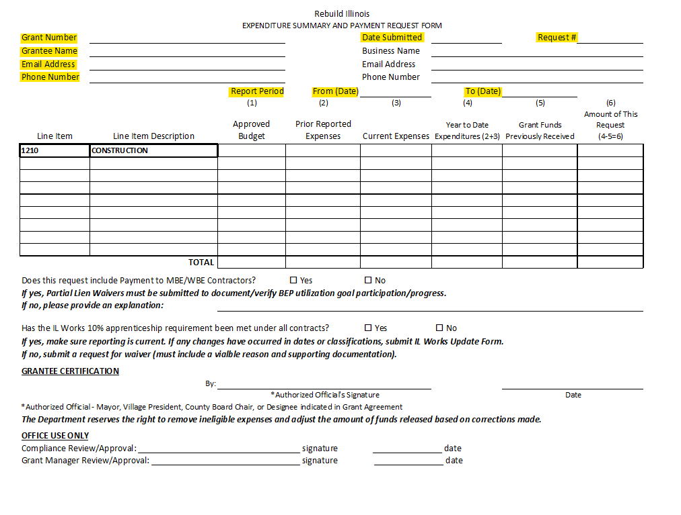
Payment Request Form – Required Information
Grant Number
Grant Name
Email Address
Phone Number
Date Submitted
Request Number
Report Period

Slide 102
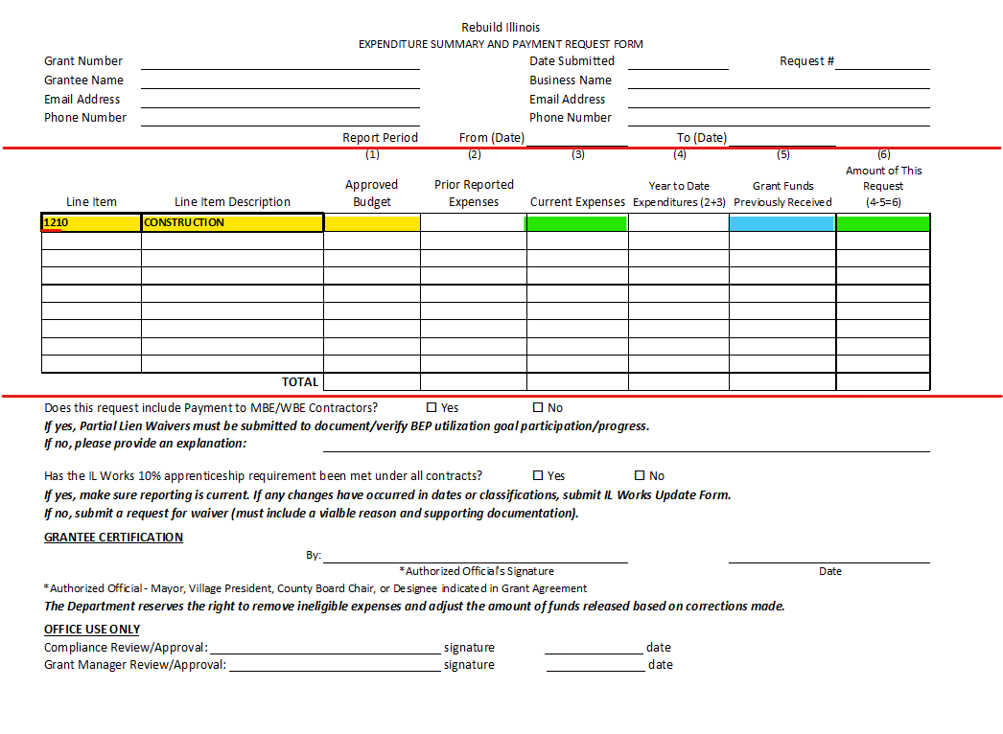
Payment Request Form – Required Information
GATA Budget information
Prior Expenses
Current Expenses
Year-to-Date Total
Grant Funds Previously
Received
Amount of This Request

Slide 103
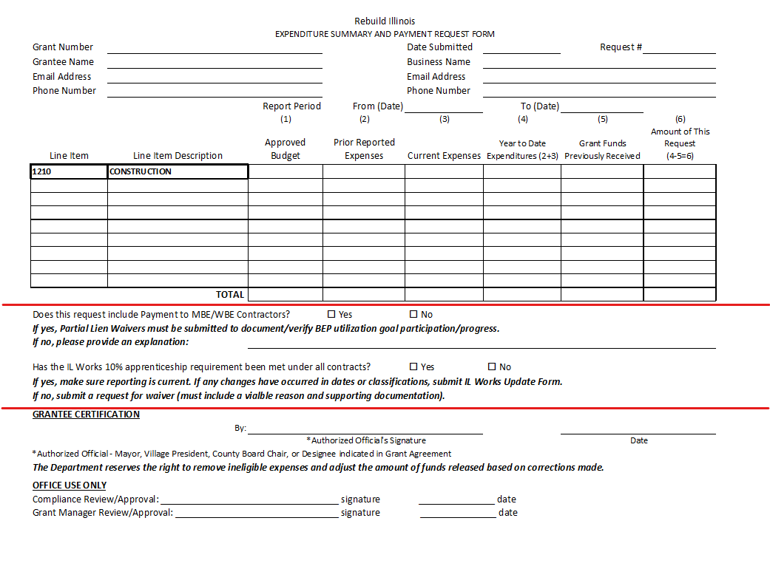
Payment Request Form – Required Information
Are there payments to Women Business Enterprise (WBE) and/or Minority Business Enterprise (MBE) Contractors on this request?
Has the IL Work Apprenticeship Requirement been met by all contacts?

Slide 104
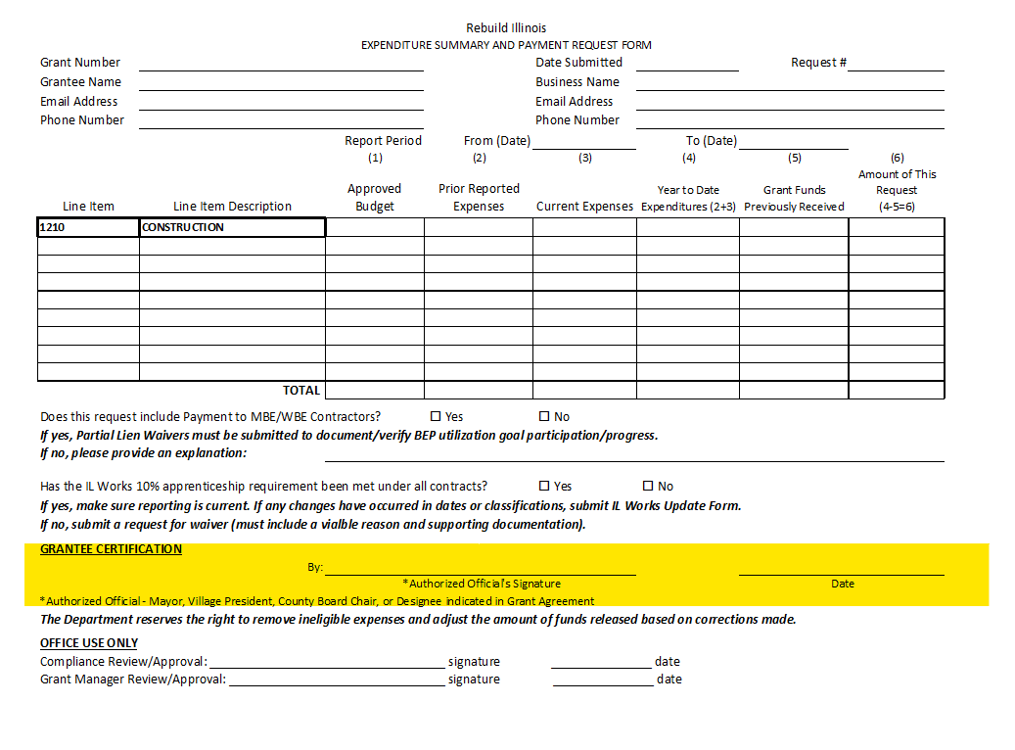
Payment Request Form – Required Information
Must have original signature, no copies, no signature stamps, etc.

Slide 105
Required Documentation
Documentation must be submitted that demonstrates allowable expenses and payment verification for those expenses.
EXPENSE DOCUMENT EXAMPLES:
Invoices
Approved pay estimates
Contractors pay request
PAYMENT VERIFICATION EXAMPLES:
Cancelled Checks
Bank Statements

Slide 106
Cash Requests and Expense Reports
The grantee will submit a complete and signed Expenditure Summary and Payment Request Form with supporting documentation and partial lien waivers to their grant manager.
Once the request is reviewed and approved with eligible costs and BEP obligations, a cash request will be entered into the “Grantee Reporting System” (GRS) by your Grant Manager.
Grantees can expect the State Comptroller to issue payment within 10 business days after the grant manager
completes the GRS entry.

Slide 107
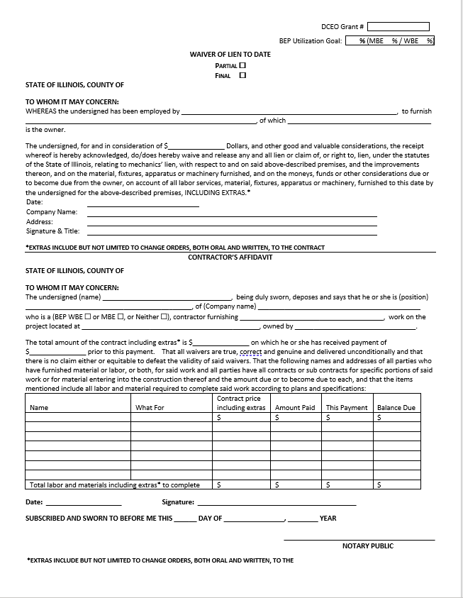

Lien Waivers and Cash Requests
Lien Waivers are submitted with Cash Requests when a BEP vendor has been paid and the grantee is seeking reimbursement for those expenses.
Allows grant managers to confirm BEP goals are met per the approved Utilization Plan.

Slide 108
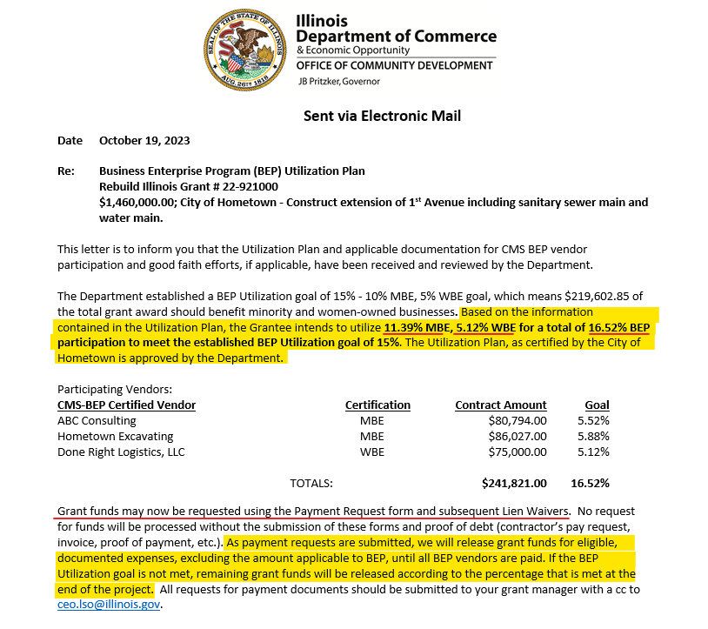
Utilization Plan & Lien Waiver Comparison
The BEP Utilization Plan Approval Letter indicates the approved BEP contract amounts.
The total BEP Contract Amount will be reserved until all BEP vendors are paid.
No or slow payments to CMS BEP certified vendors will affect the release of grant funds.

Slide 109
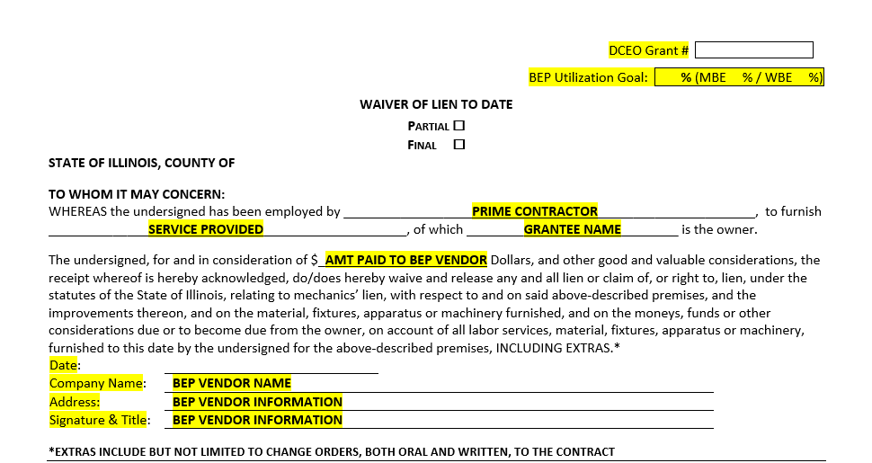
Lien Waiver Completion

Slide 110
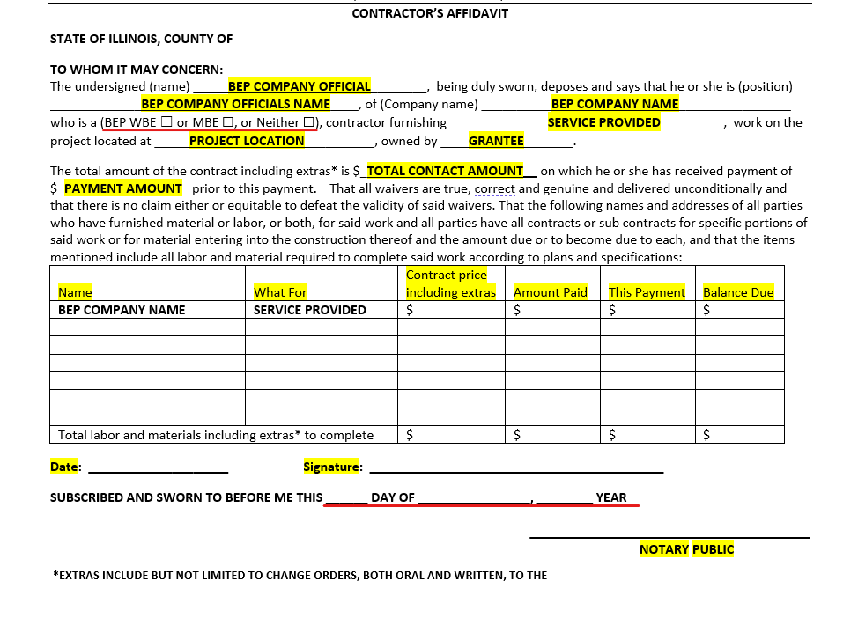
Lien Waiver Completion

Slide 111
Lien Waivers and Cash Requests
Grantees must submit Partial Lien Waivers with Requests for Payment to receive grant funds. There is a place on the request form where you will indicate if BEP vendors were paid.
When submitting a FINAL cash request at grant close-out, grantees will include a Final Lien Waiver. This will include the amount of all contracts from subcontractors and suppliers for which final lien waivers were not previously submitted.
The Department will withhold the amount of grant funds applicable to the BEP goal percentage until all CMS BEP certified vendors have been paid and the BEP Utilization goal is met.
Completed cash requests, documentation and lien waivers should be emailed to your Rebuild Illinois grant manager and JoLaine should be copied on the message
at CEO.LSO@illinois.gov

Slide 112

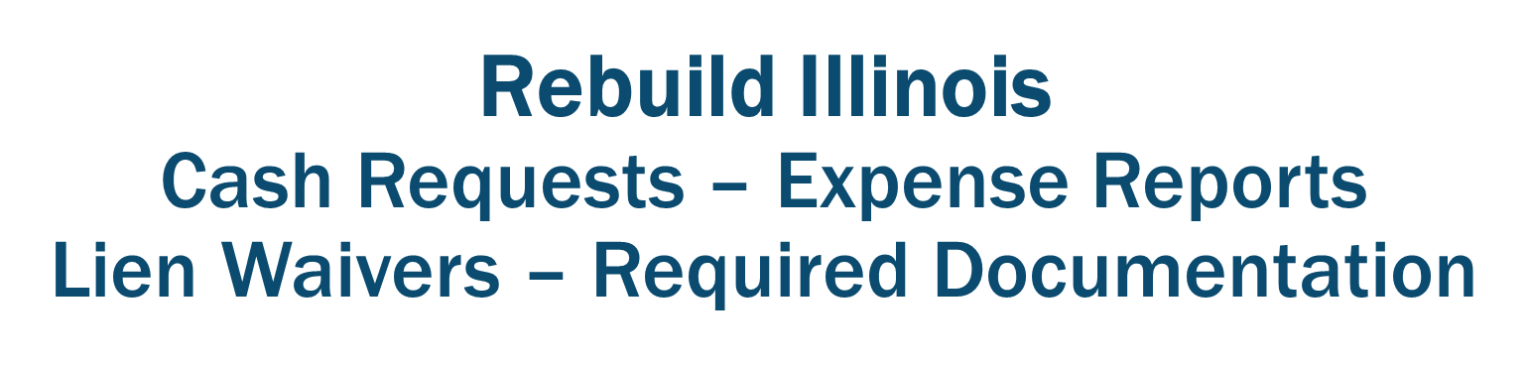

Slide 113

Rebuild Illinois Administration
Quarterly Reporting
Mandi Ferguson

Slide 114
Quarterly Periodic Reporting
The Office of Community Development monitors grant programs through Periodic Performance Reports (PPR) and Periodic Financial Reports (PFR). This helps grant managers determine if:
Grantees are carrying out the community development program and activities as described in the grant application and grant agreement.
Grantees are carrying out activities in a timely manner
These reports will give your grant manager a quarterly “check-up” on the financial and performance health of your grant.

Slide 115
Quarterly Periodic Reporting
Periodic Financial Report - PFR
Project expenditures are reported on the uniform GATA PFR report
Due quarterly and at closet-out
Scanned as a stand-alone document and sent to your grant manager
Please label with grant number, PFR and end date of reporting quarter:
22-921000 PFR 09/30/23
Periodic Performance Report - PPR
Project performance updates are reported on this uniform GATA PPR report
Due quarterly and at close-out
Scanned as a stand-alone document and sent to your grant manager
Please label with grant number, PPR and end date of reporting quarter:
22-921000 PPR 09/30/23

Slide 116
Periodic Financial Reporting
An expense should not be reported on the PFR until all supporting documentation is available.
The supporting documentation provided must exactly match the dollar amount the grantee is reporting for each source of funds.
Only report the expenses in the quarter that have a complete transaction – debt verification, payment verification and the deposit of grant funds covering expenses being reported in that period.
Include the Expenditure Summary and Payment Request form as part of the support documentation for the reporting period.

Slide 117
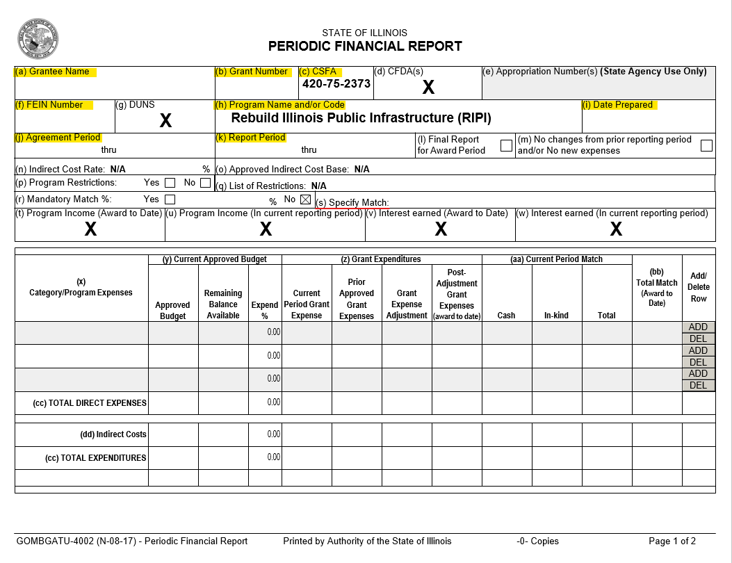
Periodic Financial Report
The information required to complete the first section of the Periodic Financial Report (PFR) may be found in the Grant Agreement.

Slide 118
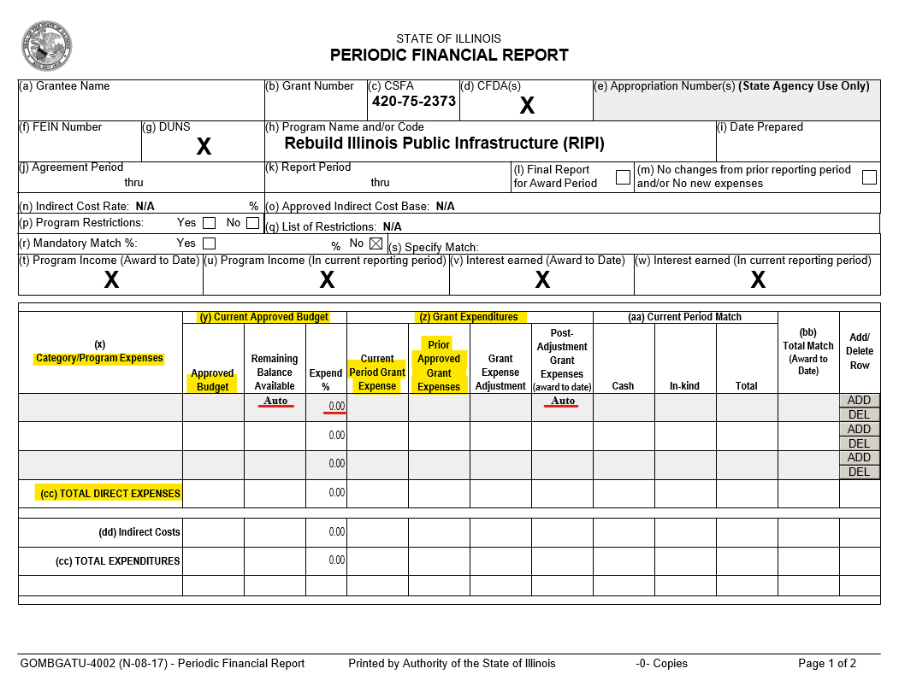
Periodic Financial Report
The supporting documentation for the Current Period Grant Expenses (z) should be the same documents that were submitted with your Expenditure Summary and Pay Request Form that were submitted within the same Reporting Period.

Slide 119
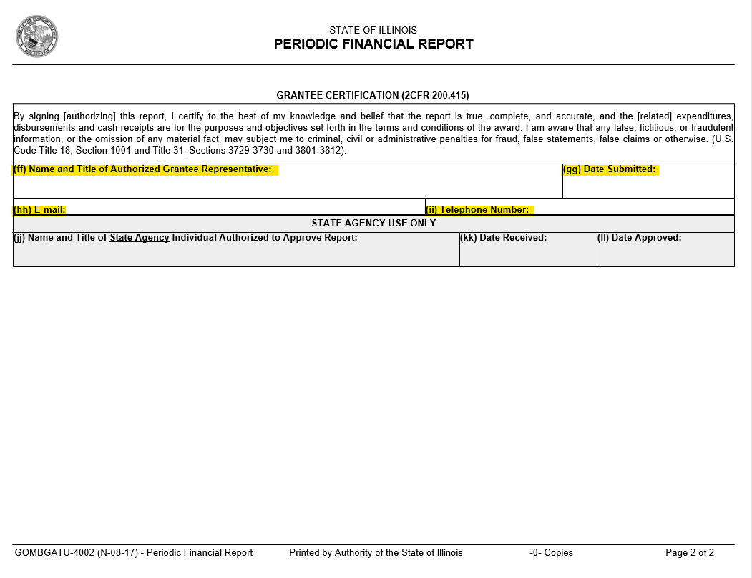
Periodic Financial Report
The Grantee Certification page must be signed by the authorized official or designee as indicated in the grant agreement.

Slide 120
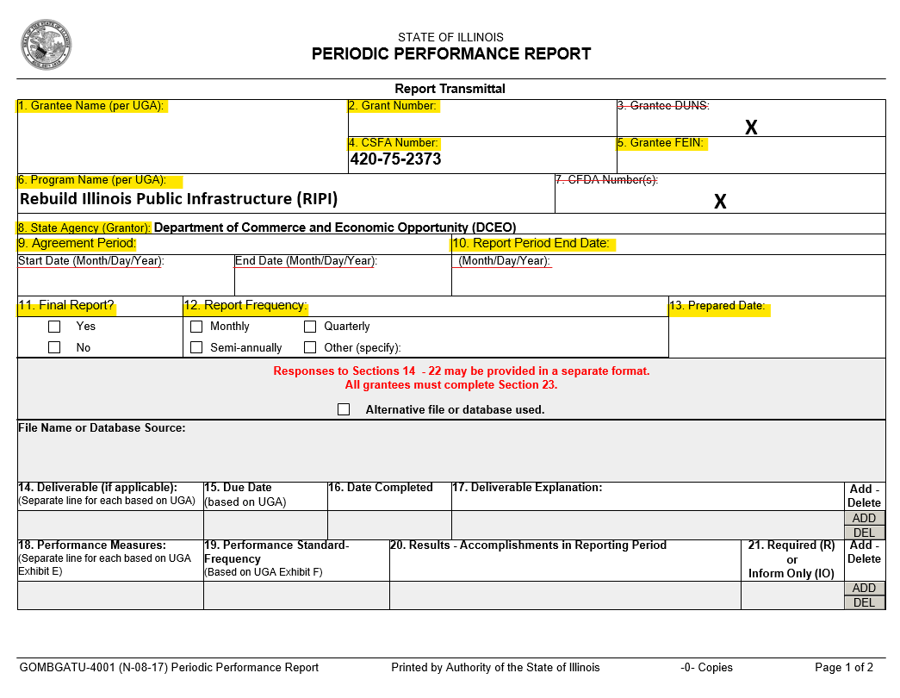
Periodic Performance Report
The information required to complete the first section of the Periodic Performance Report (PPR) is the same information used in the Financial Report (PFR).

Slide 121
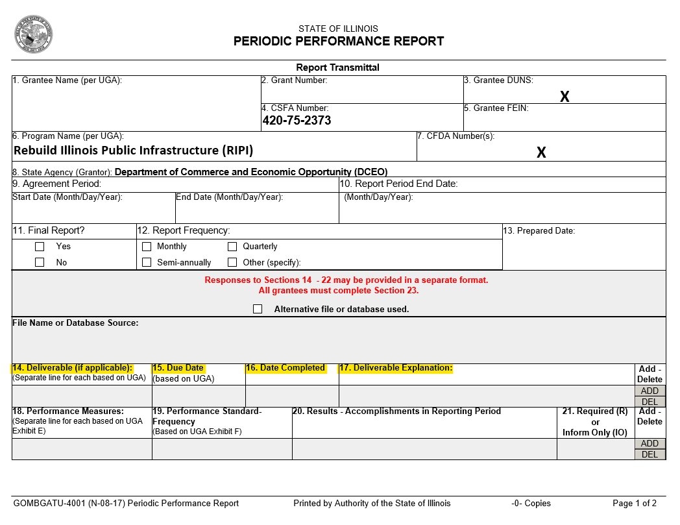
Periodic Performance Report
14. Deliverable
- Project
15. Due Date
- Due date for the deliverable,
which is the grant end date.
16. Date Completed
- Enter the date the Deliverable
task was completed. Should be
blank until last report when
project is complete
17. Deliverable Explanation
- This will be left blank until the
final report.

Slide 122
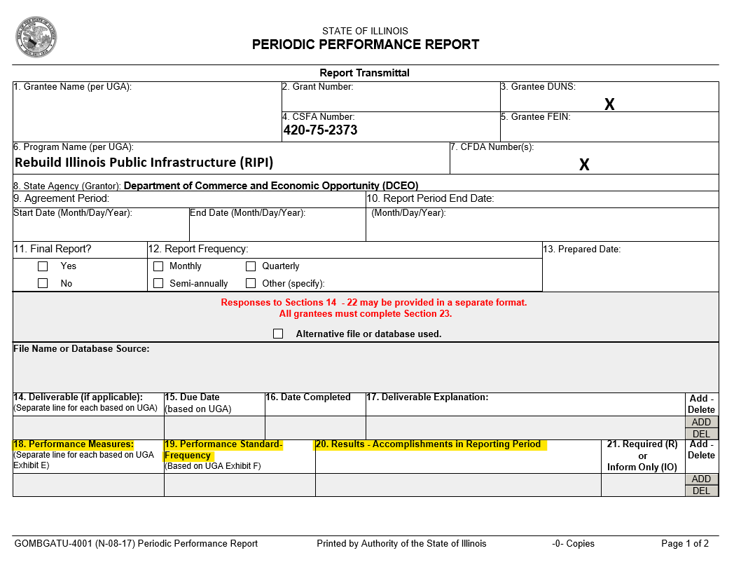
Periodic Performance Report
18. Performance Measures
- Found in UGA
19. Performance Standard - Frequency
- “End of Grant Period” should be
entered here until project is
complete.
20. Results – Accomplishments in
Reporting Period
- Provide details about the projects
progress during the reporting
quarter.

Slide 123
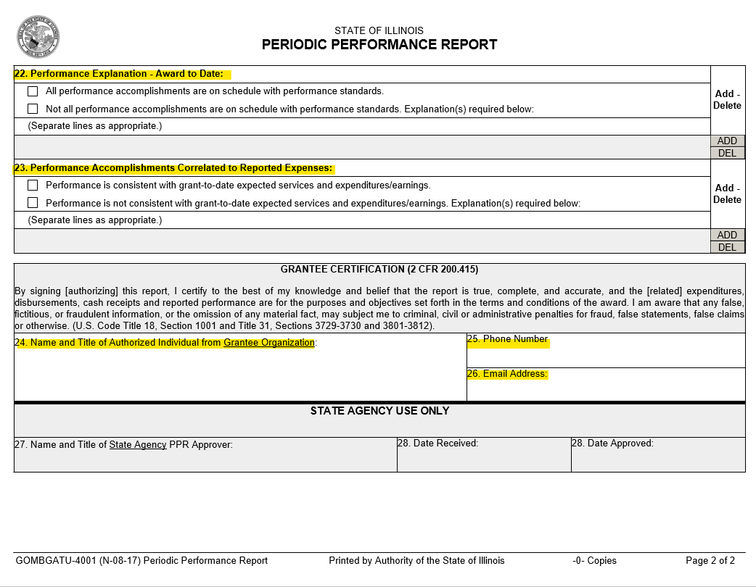
Periodic Performance Report
The Grantee Certification page must be signed by the authorized official or designee as indicated in the grant agreement.

Slide 124
Quarterly Periodic Reporting
Do not reuse report forms. Start a new form for each grant each quarter.
If a report is not correct when submitted, your grant manager will send it back with notes on what needs to be corrected.
Scanned as a stand-alone document and sent to your grant manager
If a corrected report is not received within 30-days of notification of errors, a FEIN lock will be placed on the grant/local government.
Grantee Email Reminders:
No report 1-week from due date:
  Grant Administrator will receive a “Scheduled Report Item Due” email
No report by due date:
  Authorized Official and Grant Administrator will receive a “Notification of Reporting Non-Compliance” email

Slide 125


Rebuild Illinois
Quarterly Reporting

Slide 126
Rebuild Illinois Administration
Grant Closeouts
Peyton Bernot

Slide 127
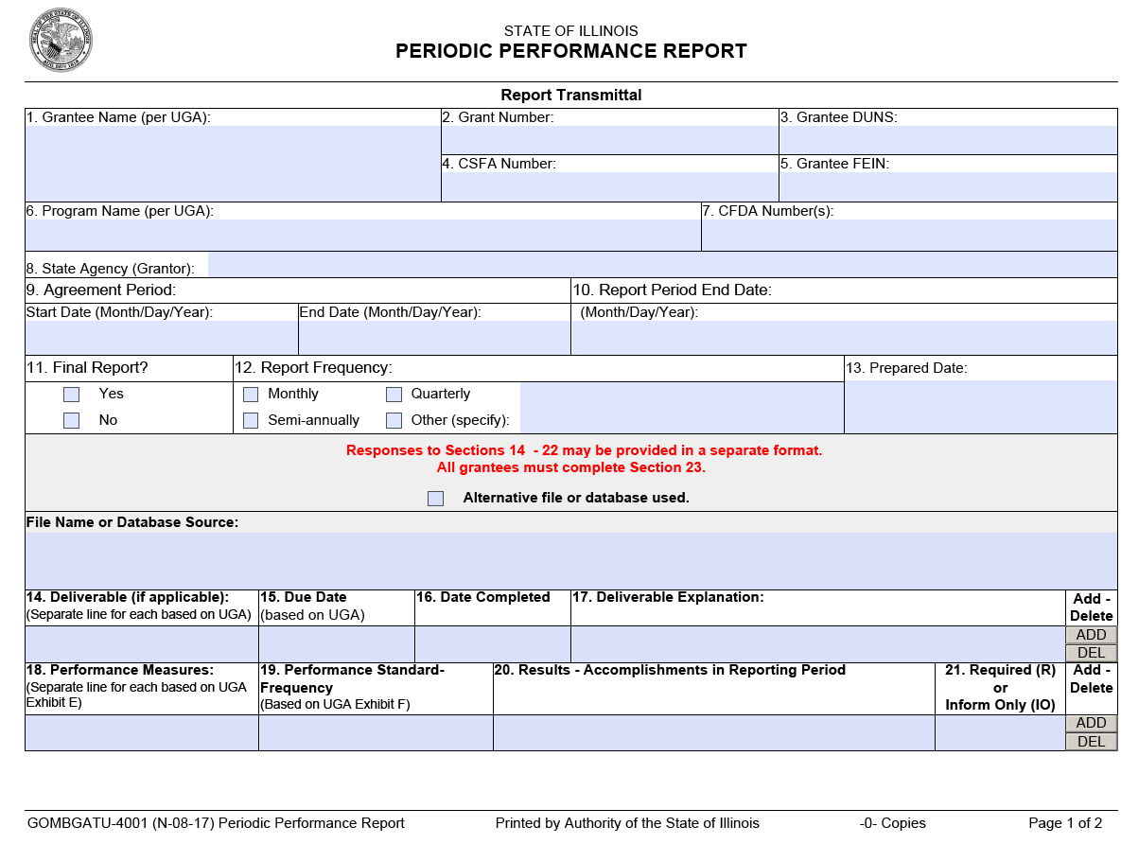
Quarterly PPR

Slide 128
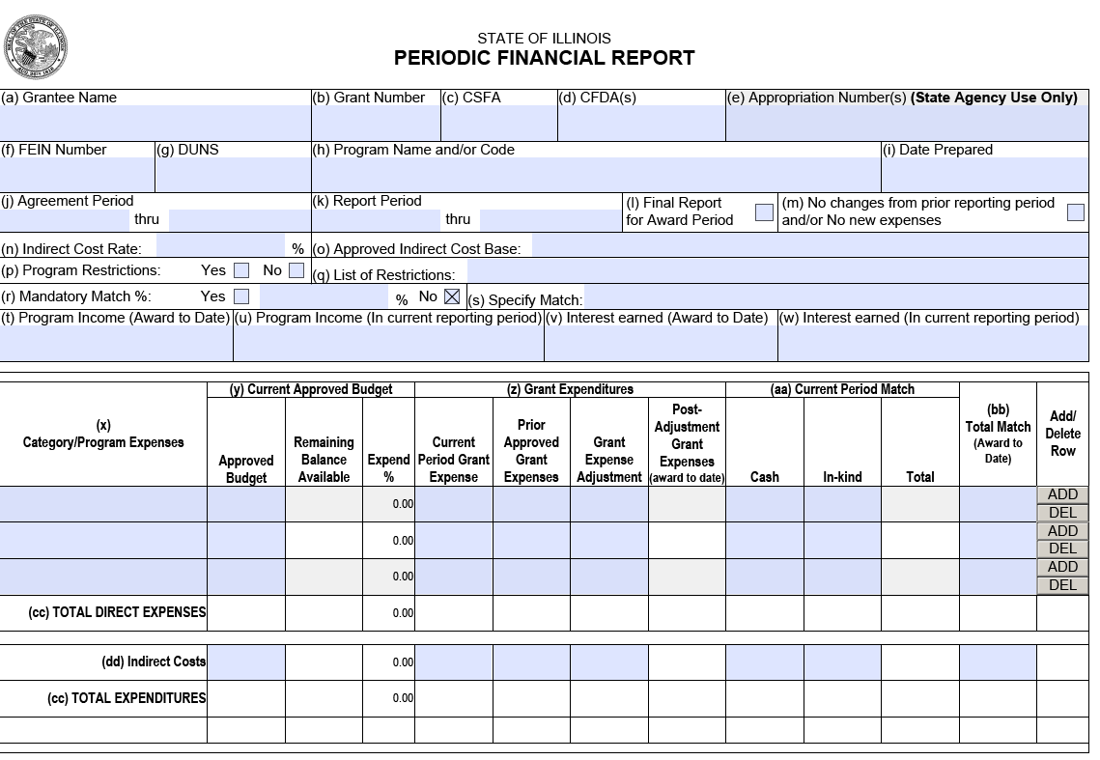
Quarterly PFR

Slide 129
Other Items for Closeout
Illinois Works Jobs Program Act Certification of Complianace with Public Works Project Apprenticeship Goals
On-site monitoring
As-built maps
Final quarterly Illinois Works report
Construction management documents
  Bids Tabs
  NOCA
  Contract and Agreement
  Notice to Proceed
  Certified Transcript of Payroll

Slide 130
Rebuild Illinois Administration
Grant Retention Administrative Files
Regina Watts

Slide 131
Grantee Records Retention
The Department requires that a filing system be established that makes all the necessary source documents readily accessible.
  The Retention Checklist will be sent with the Grant Agreement.
  A copy of a completed Retention Checklist along with the required documentation on the checklist must be kept in the Grantee project file.
  All grant records must be maintained for a minimum of three years after the closeout of the grant.

Slide 132
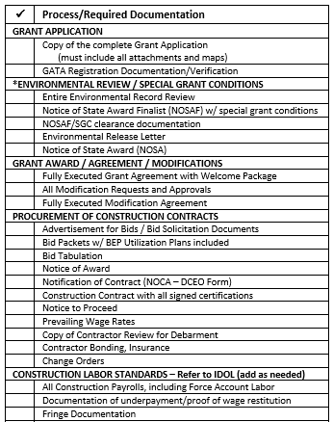
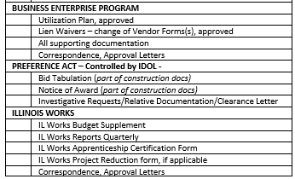
Filing System

Slide 133
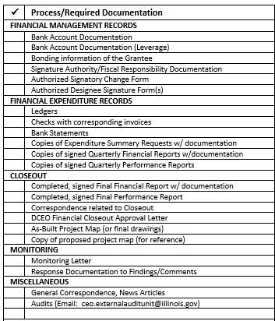
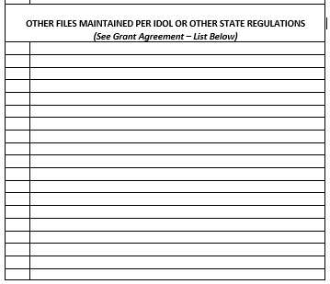
Filing System

Slide 134
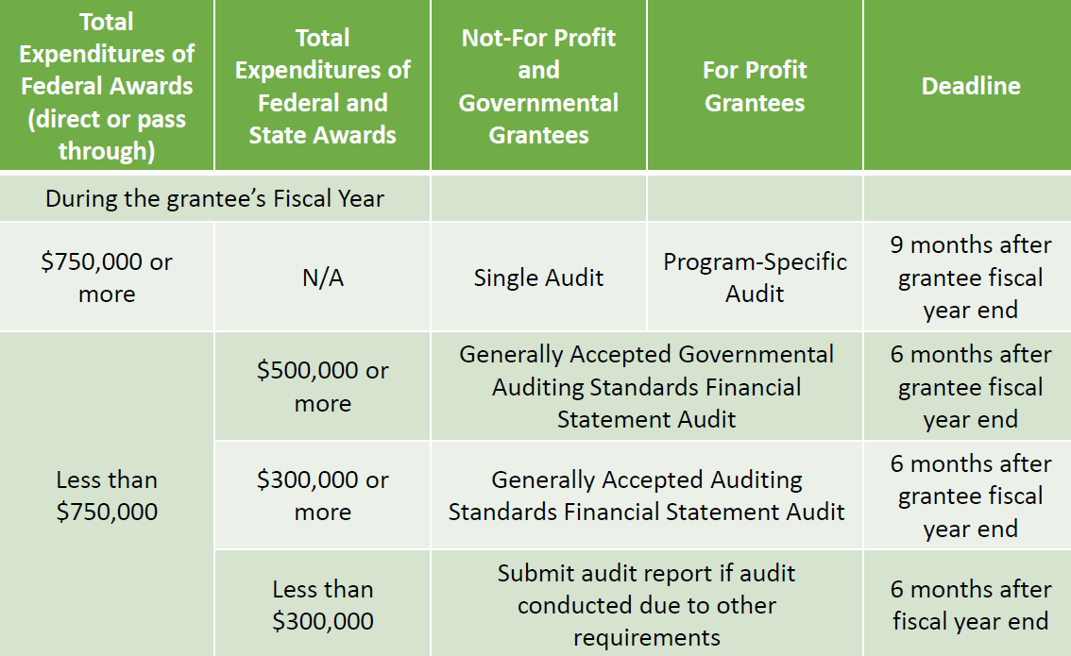
Audit Requirements

Slide 135
Audit Requirements
The State of Illinois is required to obtain and review the audit of all entities that had any State or Federally participating funds pass through it.
The appropriate audit reporting package must be submitted through the Grantee Portal at grants.illinois.gov/portal
Non-compliance with audit requirements could result in implementation of the Grantee Compliance Enforcement System (GCES) and may result in the inability to receive grant funds
Helpful Resources
  https://dceo.illinois.gov/aboutdceo/grantopportunities.html

Slide 136
Audit Requirements
The State of Illinois is required to obtain and review the audit of all entities that had any State or Federally participating funds pass through it.
The appropriate audit reporting package must be submitted through the Grantee Portal at grants.illinois.gov/portal
Non-compliance with audit requirements could result in implementation of the Grantee Compliance Enforcement System (GCES) and may result in the inability to receive grant funds
Helpful Resources
  https://dceo.illinois.gov/aboutdceo/grantopportunities.html
  DCEO Office of Accountability
  ceo.GrantHelp@illinois.gov

