Slide 1



IL ARPA: NEU Webinar
October 2022
Thank you for joining,
we’ll begin our session soon!

Slide 2

Updates:
Reminder – as a non-entitlement unit (NEU), your reporting requirement with the U.S. Treasury is on an annual basis. The next reporting deadline is on April 30, 2023.
2nd tranche payments – The state released the second tranche to all NEUs at the end of September.
If you received an email from Treasury that you need to upload your Title VI or Terms and Conditions document, please email us for a copy at ILARPA@crowe.com
For the most up-to-date information, please visit http://illinois.gov/dceo/neu This includes important links to US Treasury, dates to upcoming support webinars and access to past webinar information.

Slide 3
Standard Allowance:
Treasury expects to keep this portion of the reporting portal open through the April 2023 reporting period in order to provide an opportunity for annual reporters to take advantage of this flexibility
Standard Allowance allows you to claim your entire allotment under revenue loss without calculating the actual lost revenue.
Recipients can use their funds on government services that generally include any service traditionally provided by a government, unless Treasury has stated otherwise.

Slide 4
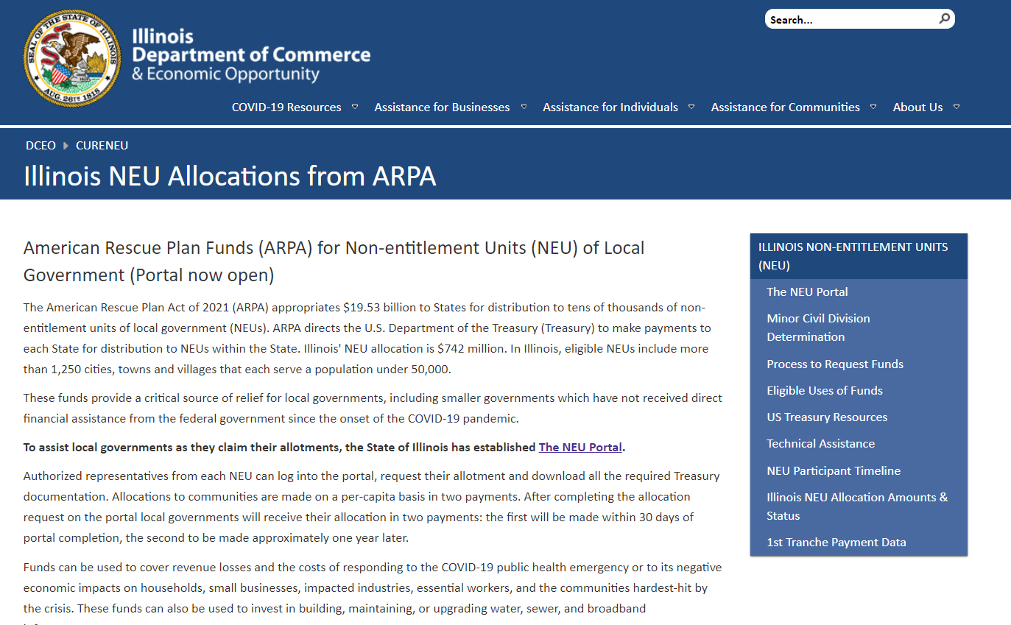
Resources:
Reminder!
Bookmark: http://illinois.gov/dceo/neu
For direct assistance, you can reach our team at ILARPA@crowe.com or
CEO.CURE@illinois.gov

Slide 5
Q & A
We want to hear from you! Questions?
Use the ‘raise hand’ feature, facilitator will ask you to un-mute.

Slide 6
For additional questions:
please email us at ILARPA@crowe.com

