Slide 1


$15 million Tourism Attractions & Festivals Grant Program

Slide 2
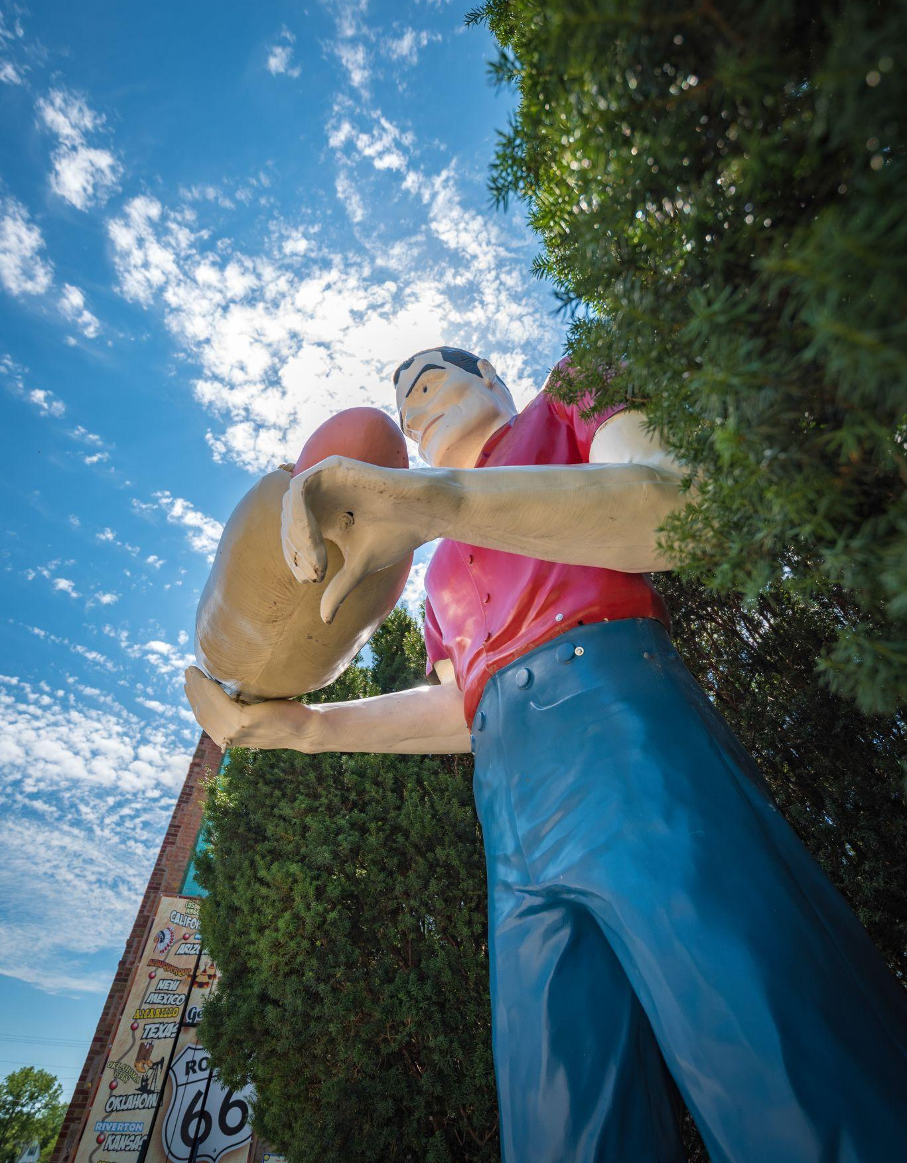
Presenters
Jan Kemmerling, DCEO, Illinois Office of Tourism
Libby Shawgo, DCEO, Office of Grants Management, Tourism Grants Manager
Questions? Please type them into the chat box!
We will go through all questions at the end of
the session.

Slide 3
Pre-Qualification Overview

Slide 4
Competitive Grant Lifecycle
Pre-Award Requirements
Application Submission/Review
Active Grant
Valid UEI number
Current SAM.gov account
Not be on the Federal Excluded Parties list
Be in Good Standing with the Illinois Secretary of State
Not be on the IL Stop Payment List
Fiscal and Administrative Risk Assessment
NOTE: can all be found at grants.Illinois.gov/portal
Merit Review Committee
Programmatic Risk Assessment Questionnaire
Accepted Applicants will Receive Notice
Grant Agreement Execution
NOTE: application and information above can be found on the Catalog of State Financial Assistance (CSFA) or DCEO staff for direct grants
Grant funds are paid on a reimbursement basis, except an initial working capital advance
Grant funds will be disbursed upon approval of expenditure reports

Slide 5
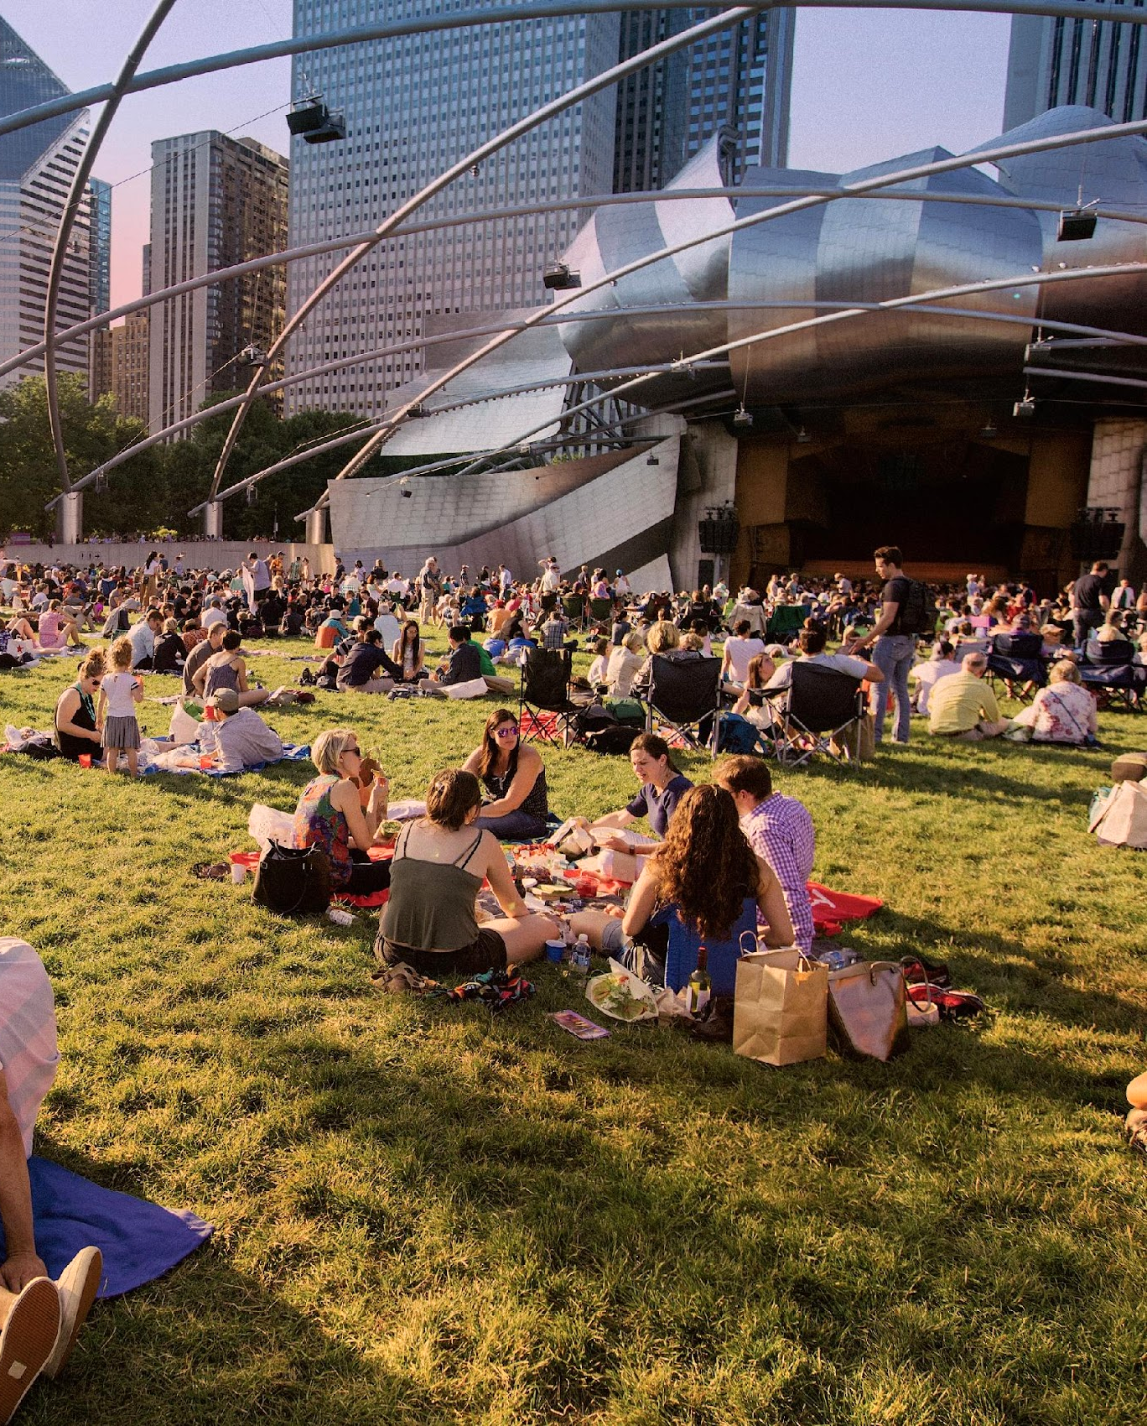
Unique Entity Identifier (UEI)
Tracking database of all government contractors.
https://sam.gov/content/entity-registration
Note: this is a free registration process.

Slide 6
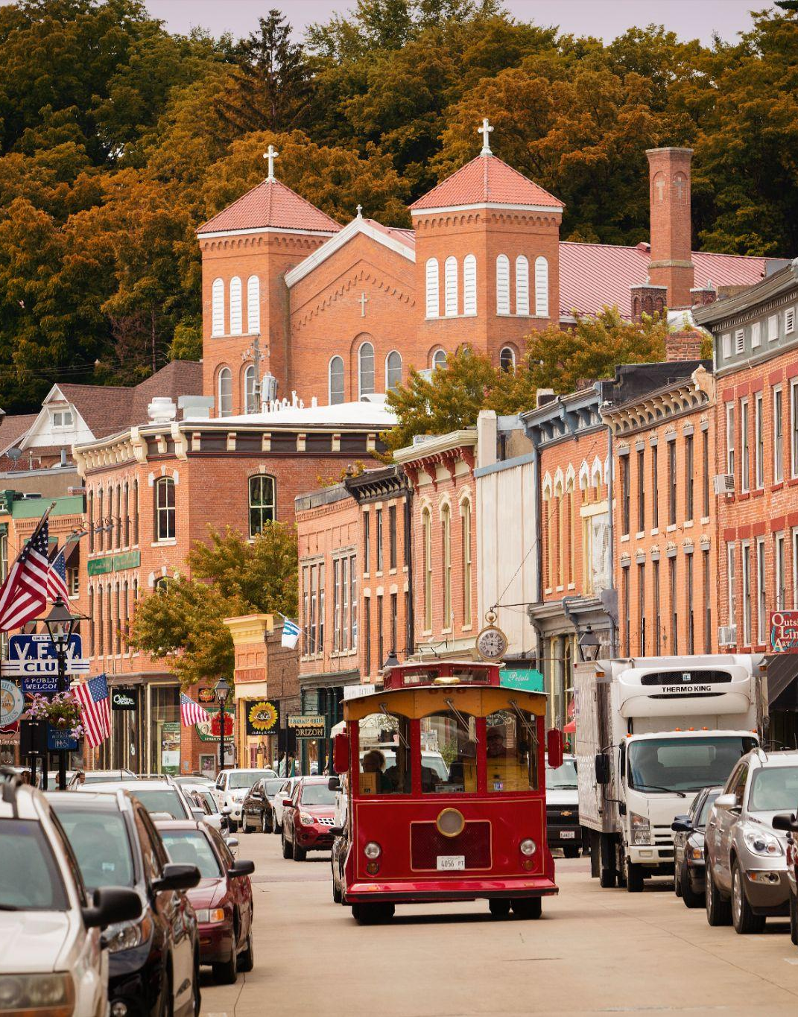
System for Award Management
Central registration point for all government contractors and review of federal stop pay lists.
Make registration public for quicker pre-qualification
https://sam.gov
Note: this is a free registration process.

Slide 7
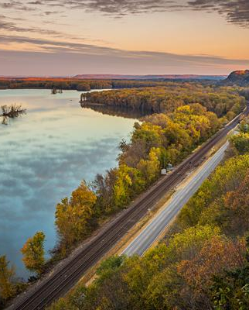
Certificate of Good Standing
Verified from the IL Secretary of State that organization is registered and up to date.
https://www.cyberdriveillinois.com/departments/business_services/corp.html

Slide 8
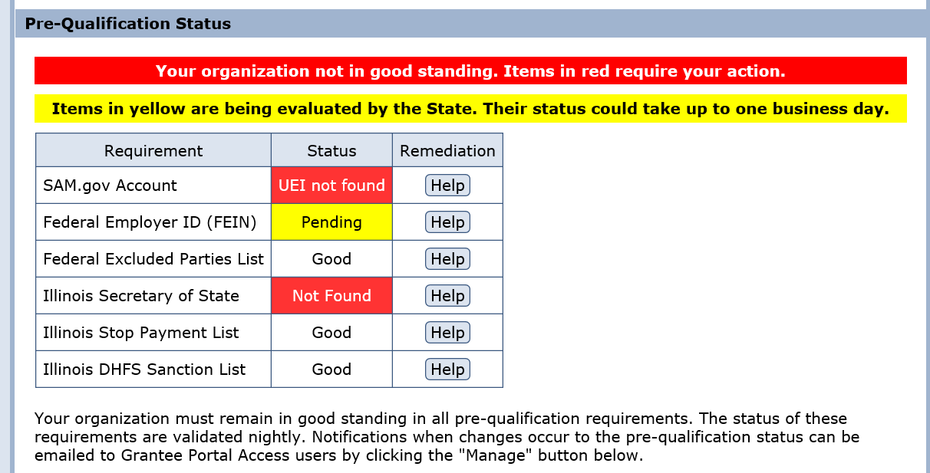
Pre-Qualification
Must be registered and pre-qualified to apply for a grant
Pre-qualification is dynamic and updated nightly
FEIN/UEI/SAM/ILSOS is automatically verified by system
Automated emails sent when status changes

Slide 9
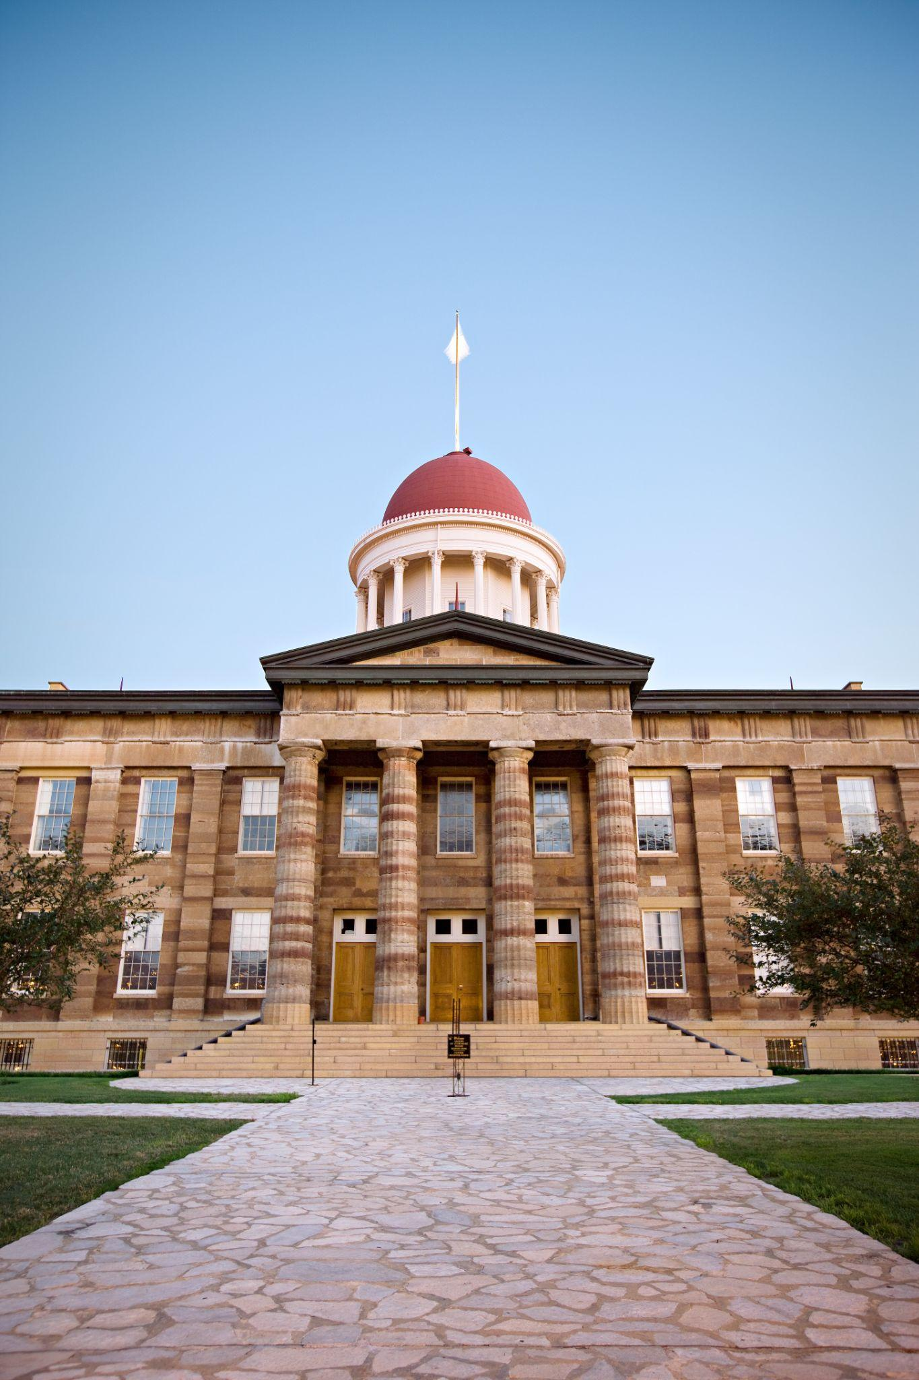
IL Stop Payment List
A Grantee would be on this list for not meeting terms of past grants with the State of Illinois.
Will receive notifications re: noncompliance prior to being added to IL Stop Payment List.
Statewide enforcement: can not apply/modify grant agreement or receive grant funds.
Review status in the Grantee Portal.

Slide 10
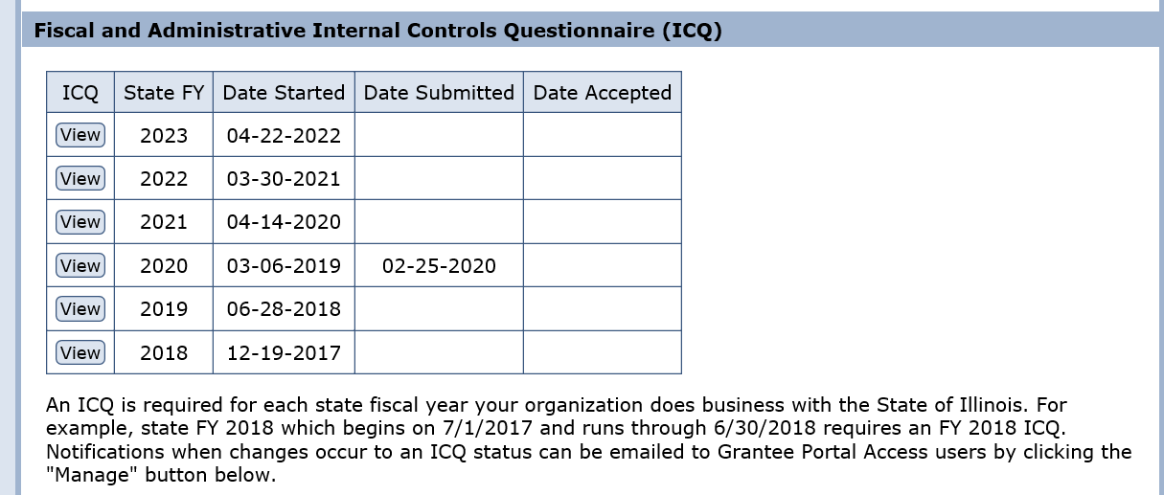
Fiscal and Administrative Risk Questionnaire
Must be completed in the Grantee Portal annually to assess the Grantee’s ability to manage grants. Results used by all State Agencies.
Result of questionnaire may result in specific conditions. Is not punitive. Mitigates risk and builds grantee capacity.

Slide 11
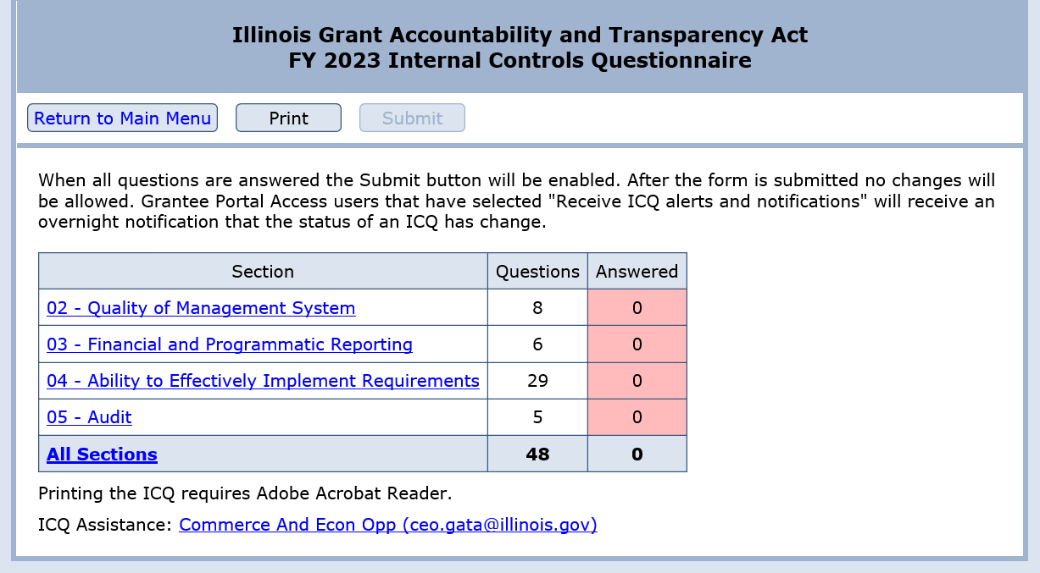
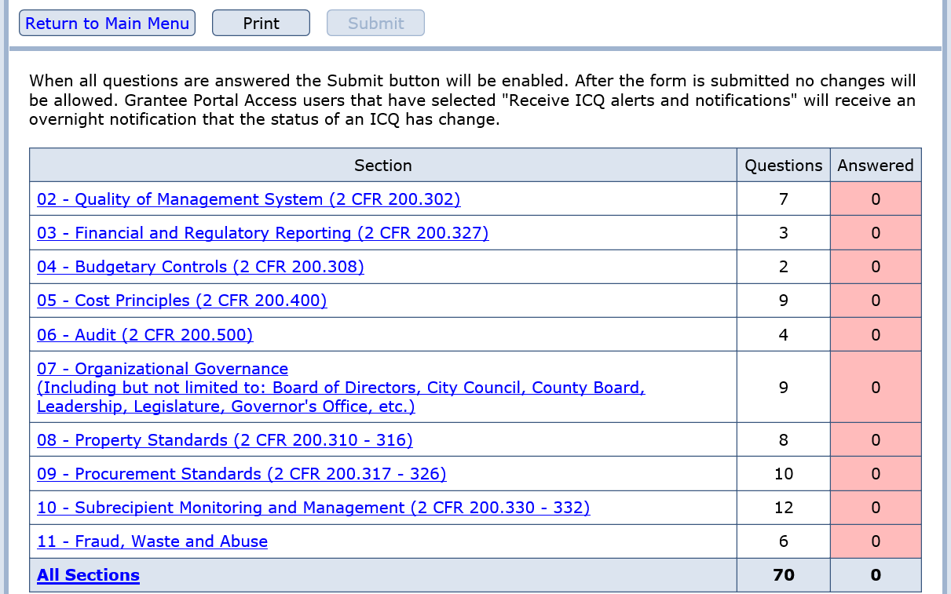
Fiscal and Administrative Risk Questionnaire
ICQ for FY22 and previous
ICQ for FY23 and beyond

Slide 12
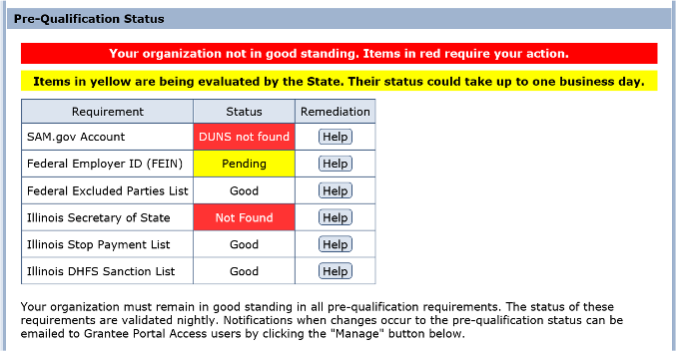
Pre-qualification
Must be registered and pre-qualified to apply for a grant
Pre-qualification is dynamic and updated nightly
FEIN/UEI/SAM/ILSOS is automatically verified by system
Automated emails sent when status changes

Slide 13
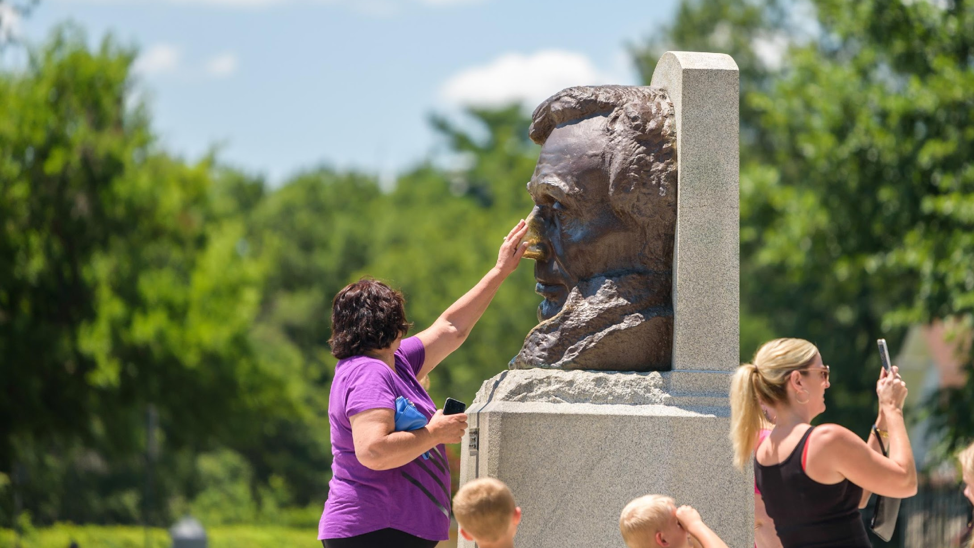
State of Illinois Grantee Portal
Go to: https://grants.Illinois.gov/portal/
Create Account
Verify email
Go back to: https://grants.Illinois.gov/portal/
Sign In Here
Read and Accept Usage Terms and Conditions
Enter your entity’s UEI
Create Grant Account
Sign into https://grants.Illinois.gov/portal/ to manage account, etc.

Slide 14
Competitive Grant Lifecycle
Pre-Award Requirements
Application Submission/Review
Active Grant
Valid UEI number
Current SAM.gov account
Not be on the Federal Excluded Parties list
Be in Good Standing with the Illinois Secretary of State
Not be on the IL Stop Payment List
Fiscal and Administrative Risk Assessment
NOTE: can all be found at grants.Illinois.gov/portal
Merit Review Committee
Programmatic Risk Assessment Questionnaire
Accepted Applicants will Receive Notice
Grant Agreement Execution
NOTE: application and information above can be found on the Catalog of State Financial Assistance (CSFA) or DCEO staff for direct grants
Grant funds are paid on a reimbursement basis, except an initial working capital advance
Grant funds will be disbursed upon approval of expenditure reports

Slide 15

Before you Apply:
Read the entire Notice of Funding Opportunity
  Procurement requirements
  Audit requirements
  Eligible use of funds
  Goals of the program
Assess your organization’s internal tracking system
Assess your organization’s capacity to manage program and report outcomes
Ask questions!

Slide 16
Competitive Grant Lifecycle
Pre-Award Requirements
Application Submission/Review
Active Grant
Valid UEI number
Current SAM.gov account
Not be on the Federal Excluded Parties list
Be in Good Standing with the Illinois Secretary of State
Not be on the IL Stop Payment List
Fiscal and Administrative Risk Assessment
NOTE: can all be found at grants.Illinois.gov/portal
Merit Review Committee
Programmatic Risk Assessment Questionnaire
Accepted Applicants will Receive Notice
Grant Agreement Execution
NOTE: application and information above can be found on the Catalog of State Financial Assistance (CSFA) or DCEO staff for direct grants
Grant funds are paid on a reimbursement basis, except an initial working capital advance
Grant funds will be disbursed upon approval of expenditure reports

Slide 17

Active Grant Requirements
Periodic Financial Report (outside Grantee Portal)
Periodic Performance Report (outside Grantee Portal)
Consolidated Year End Financial Statement and Audit (in Grantee Portal)

Slide 18
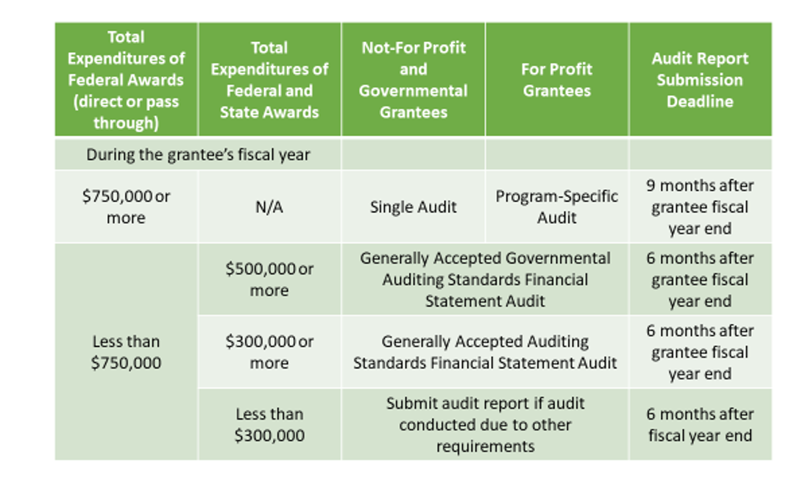
Audit Types and Submission Deadlines
Beginning in FY23, expenditures of direct federal awards are not to be included in the calculations of whether GAAS or GAGAS audits are required. It will only be state awards and federal awards passed through by the state to the subrecipient.

Slide 19

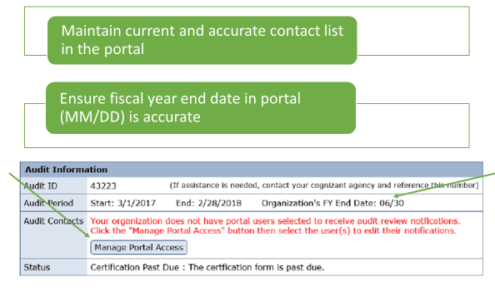
Other Important Tips for Grantee Portal

Slide 20
Tourism Attractions & Festivals Grant Program
The purpose of this opportunity is aimed at revitalizing the hard-hit tourism industry by bringing back new and returning tourism attractions and festivals/events to our state.
$15,000,000 will be awarded under this opportunity
Awards can range from $15,000 - $500,000
Applications are due by 5 PM on 9/23
Applicants may only submit one (1) application for this program
Applicants can apply in one of two categories:
  Tourism Attractions
  Tourism Festivals & Events

Slide 21
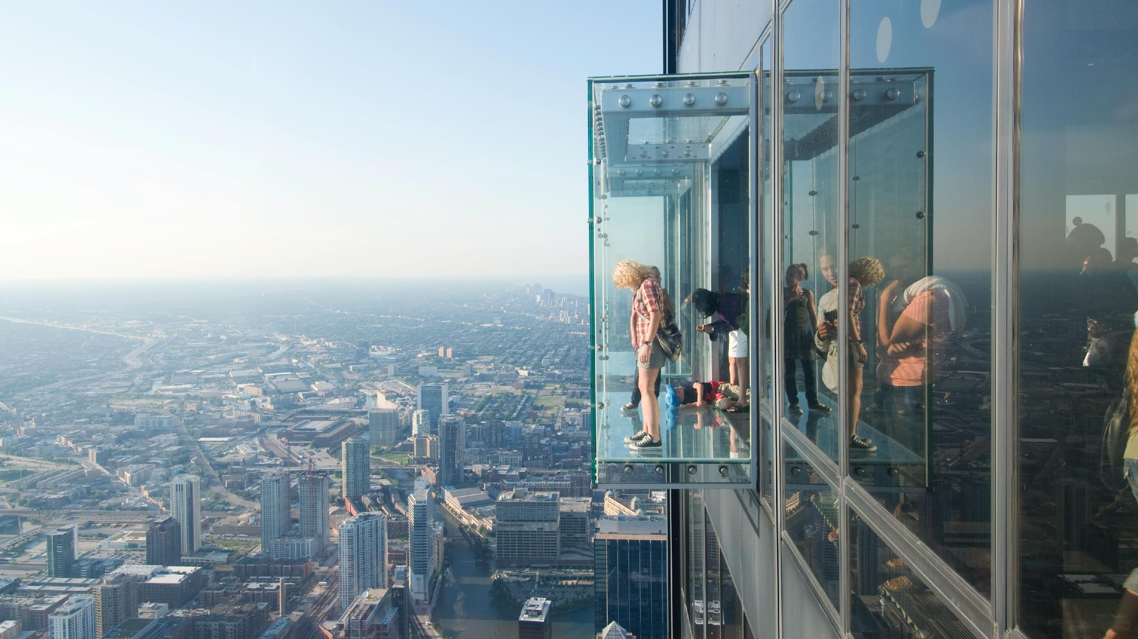




Eligible Applicants
Units of local government
Counties
Municipalities
Not-for-profit organizations
For-profit businesses
Local promotion groups

Slide 22
Definitions
Tourism Attractions are defined as fishing and hunting areas, State parks, historical/cultural sites, areas of historic or scenic interest, museums, recreation areas, botanical gardens, theme/amusement parks, interpretive programs and other facilities or businesses that attract or serve visitors that are open to the public for a minimum of 100 days per year and are marketed and promoted to visitors from more than 50 miles away.
Tourism Events are defined as an event, such as a major convention, trade show, sporting activity or festival, with potential to attract visitors from outside a 50-mile radius and to produce significantly increased economic impact for the State of Illinois through overnight stays.
Tourism Festivals are defined as an organized series of public activities for a specific duration which may include, but is not limited to the following activities: fairs, carnivals, exhibitions, musical and cultural performances with potential to increase economic activity within the tourism, travel and hospitality industries while generating foot traffic in neighborhoods and business corridors which have experienced a decline in economic activity due to the COVID-19 public health emergency.

Slide 23
Allowable Expenditures and Activities
Attractions Component
Expenditures and activities for which grant funds can be utilized by Grantees include, but are not limited to, the following for Tourism Attractions:
Capital projects - Land and building acquisition, construction and renovation of buildings for the purpose of creating or enhancing a Tourism Attraction;
Equipment - Purchase and installation of machinery and equipment designed to create or enhance the Tourism Attraction;
Training - Development and presentation of hospitality, quality service and/or other types of tourism training programs intended to provide a competitive workforce for the tourism industry of Illinois; and,
Interpretive Programs - Creation, implementation and staffing of, and fabrication of exhibits for, interpretive programs located within historic/cultural sites.

Slide 24

Ineligible Expenditures
Attractions Component
Ineligible projects and activities for Tourism Attractions include, but are not limited to, the following:
Studies (feasibility, research, development, marketing, etc.);
Debt refinancing;
Contingency funding;
Normal payroll or operating expenses;
Administrative expenses;
Purchase of alcoholic beverages; and
Attraction projects that have been completed.
Marketing

Slide 25
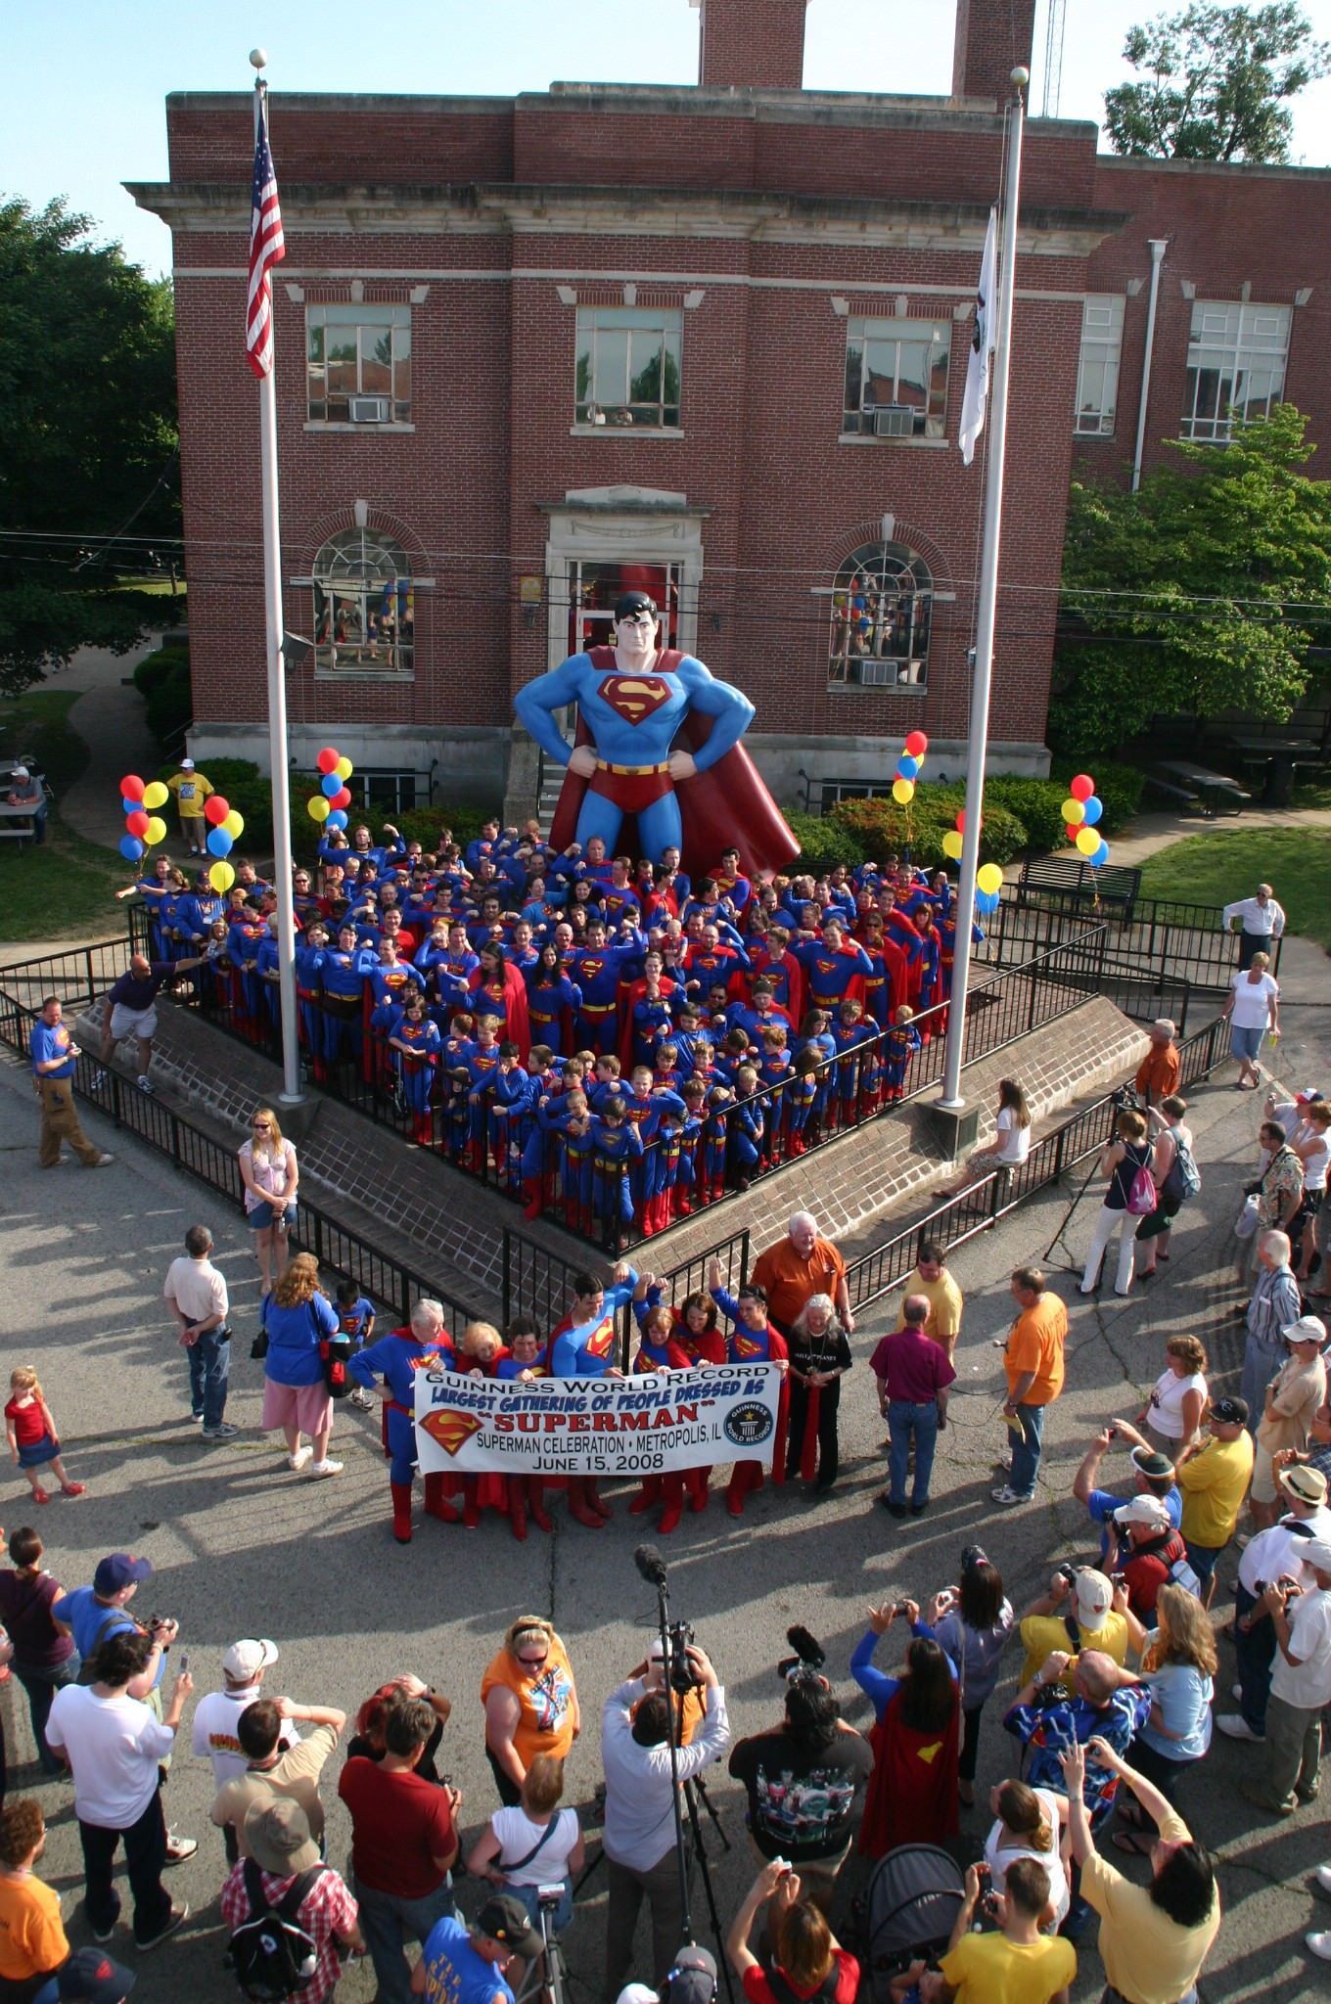
Allowable Expenditures & Activities
Festivals/Events Component
For Festivals/Events, expenditures and activities for which grant funds can be utilized by Grantees include, but are not limited to:
Transportation & Housing;
Building or equipment rental;
Receptions/banquets;
Entertainment/programming;
Photography;
Audio Visual equipment; and
Temporary staff for the festival/event.

Slide 26
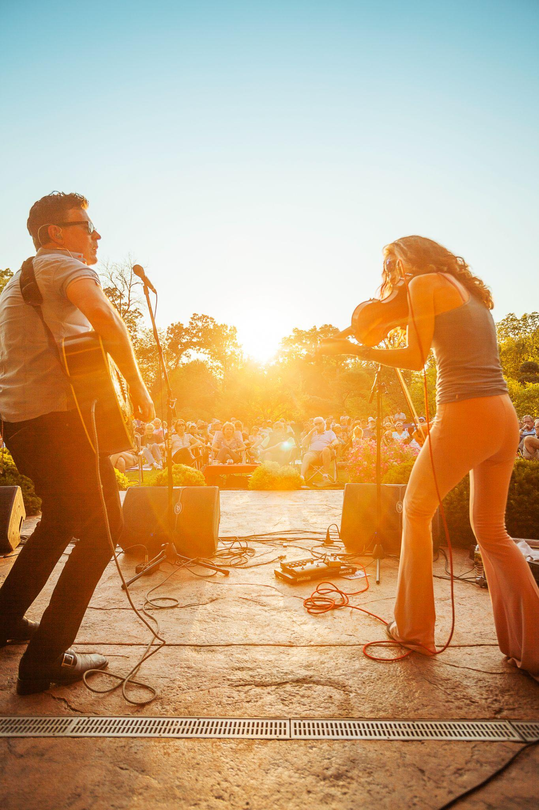
Ineligible Expenditures
Festivals/Events Component
Ineligible projects and activities for Tourism Festivals/Events include, but are not limited to,
the following:
Debt refinancing;
Contingency funding;
Normal payroll or operating expenses;
Administrative expenses, including indirect costs;
Purchase of equipment;
Purchase of alcoholic beverages; and
Marketing.

Slide 27
Cost Sharing/Match Funds
Grant applications should be for 50% of the total project costs, unless grant applicant can demonstrate significant need for a greater percentage.
At the Department’s discretion, grants to units of local government, municipalities, counties, not-for-profit organizations, or local promotion groups may exceed 50% of the entire amount of the actual expenditure for the project; however, preference will be given to applicants seeking funding for 50% or less of the entire amount of actual expenditure for the project.
If an applicant is a for-profit business, the grant amount will not exceed 25% of the entire amount of actual expenditure for the project. No one grant shall exceed $500,000.
In-kind contributions necessary to complete the project and for which the cash value is easily documented (i.e., donated labor, equipment, supplies and materials), and that are eligible grant and match line-item expenditures identified in the budget. In-kind contributions may only be used as allowable match by units of local government, municipalities, counties, not-for-profit organizations, or local promotion groups and cannot exceed 25% of the match requirement.
Please note that preference will be given to the applicants that match grant funds dollar to dollar.

Slide 28
Application Submittal
Completed application packages will be submitted via Smartsheet.
. Application materials must be submitted to the Department via electronic form at https://app.smartsheet.com/b/form/82dd17ce9b1f463b95af5dbf9f1317eb.
Application packages must contain the following items:
Uniform Grant Application in fillable PDF format (print, sign and scan signature page with submission)
Uniform Capital Budget utilizing the template provided by DCEO for this project. The entire budget with all worksheets included even if the worksheets are not relevant to the grant opportunity must
be submitted with the application materials. (print, sign and scan signature page with submission)
Conflict of Interest Disclosure
Mandatory Disclosures
Program Specific Application/Narrative

Slide 29



Application Timeline
Due by 5 PM on 9/23/2022.

Slide 30
Merit Review
This grant opportunity is competitive.
Applications will be reviewed and scored by a review committee. Scoring will be based upon the responses you provide in your application. Complete and concise responses are necessary in order to give the review committee a clear understanding of each question you are addressing. Scores will be reflective of the information you provide in each response.
The final score of each Committee member will be calculated and an average of all scores will be the final applicant score. Grants will be awarded in order from highest score to the lowest score until funding is exhausted as well as geographical dispersion will be considered. The Department expects to award at least $5 million of the $15 million for Tourism Festivals & Events. In addition, at least 30 percent of the funds will be available to communities located outside the Northeast region (Cook, Lake, McHenry, DuPage, Kane, DeKalb, Kendall, Will, Kankakee, and Grundy Counties).
An application must receive a minimum of 60 of 100 possible points to be considered eligible for funding.

Slide 31
Application Review
Attractions Component
Program Specific Applications require you to address a series of questions; the review committee will score your responses in three categories:
Need- Identification of stakeholders, facts, and evidence that demonstrate the proposal supports the grant program purpose
To what extent is the grant needed in order to develop or improve the tourism attraction?
To what extent will the development or improvement of the tourism attraction revive the tourism, travel and hospitality industries in the area of the attraction by increasing economic activity in the local area?

Slide 32
Application Review
Attractions Component
Capacity- The ability of the applicant to execute the project according to requirements of the grant program
To what extent will the tourism attraction create local partnerships with the small business community and organizations to assist them with recovery from the Pandemic?
The applicant provided detail on the estimated tourism impact for the local area of the tourism attraction.
To what extent is or will the tourism attraction be marketed to visitors and locals in order to increase attendance?

Slide 33
Application Review
Attractions Component
Quality- The totality of features and characteristics of the project that indicate its ability to satisfy the requirements of the grant program
To what extent are the costs itemized on the budget reasonable and necessary to develop a new tourism attraction or improve the tourism attraction to help increase attendance and justification for the costs provided?
To what extent are there established tracking and evaluation methodologies and performance measures with estimated outcomes to reflect the success of the tourism attraction?
The attraction meets the definition of a tourism attraction and has the required hours of operation to be able to support increasing visitation.
Is the development of the tourism attraction or improvement being done to bring in visitors and locals to the business or neighborhood to try and build back capacity to 2019 levels?
The tourism attraction is being held in an area that has experienced declines in hotel tax revenue in 2021 compared to 2019

Slide 34
Application Review
Festivals/Events Component
Program Specific Applications require you to address a series of questions; the review committee will score your responses in three categories:
Need- Identification of stakeholders, facts, and evidence that demonstrate the proposal supports the grant program purpose
To what extent is the grant needed in order to assist with costs to hold the festival or event?
To what extent will the festival or event revive the tourism, travel and hospitality industries in the area of the festival or event by increasing economic activity in the local area?

Slide 35
Application Review
Festivals/Events Component
Capacity- The ability of the applicant to execute the project according to requirements of the grant program
To what extent will the festival or event create local partnerships with the small business community and organizations to assist them with recovery from the Pandemic?
The applicant provided detail on the estimated tourism impact for the local area of the festival or event.
To what extent will the festival or event generate media coverage outside the local area to bring awareness to the festival and attract more attendance?
To what extent will the festival or event be marketed to visitors and locals in order to increase attendance?

Slide 36
Application Review
Festivals/Events Component
Quality- The totality of features and characteristics of the project that indicate its ability to satisfy the requirements of the grant program
To what extent are the costs itemized on the budget reasonable and necessary to hold the festival or event and help to increase attendance and justification for the costs provided?
To what extent are there established tracking and evaluation methodologies and performance measures with estimated outcomes to reflect the success of the festival or event?
Is the festival a new festival being created to bring in visitors and locals to the business or neighborhood or enhancement of an existing festival to try and build back capacity to 2019 levels?
Festival is being held in an area that has experienced declines in hotel tax revenue in 2021 compared to 2019

Slide 37

Complete Risk Assessments
Internal Control Questionnaire (ICQ)
  All applicants must complete this questionnaire.
  This questionnaire assesses the financial and administrative risk of the entity.
  Complete the FY’2023 ICQ on the GATA Grantee Portal
  Your application is considered incomplete and cannot be moved forward for review until this questionnaire has been completed.
Programmatic Risk Assessment (PRAQ)
  This questionnaire assesses an entity’s grant experience and ability to administer the program.
  Successful applicants will receive this assessment after application scoring and funding determination.

Slide 38
Helpful Links/Information
Catalog of State Financial Assistance:
https://www2.illinois.gov/sites/GATA/Grants/SitePages/CSFA.aspx
Pre-Award Requirements questions/problems:
CEO.GATA@illinois.gov
Stop Pay List issues:
CEO.externalauditunit@illinois.gov
Libby Shawgo, Grants Manager
CEO.TourismGrants@illinois.gov

Slide 39
More Helpful Links/Information
GATA Portal
https://grants.Illinois.gov/portal/
Smartsheet application submittal link:
https://app.smartsheet.com/b/form/82dd17ce9b1f463b95af5dbf9f1317eb.

